Slide 1
University of Maryland Baltimore County Department of Computer Science and Electrical Engineering CMPE 212 Laboratory (Discussion 13)
Hasib Hasan
ha26@umbc.edu
Edward Hanson
ehanson1@umbc.edu
Ankit Baingane
ankitb1@umbc.edu
Notes:
1

Slide 2
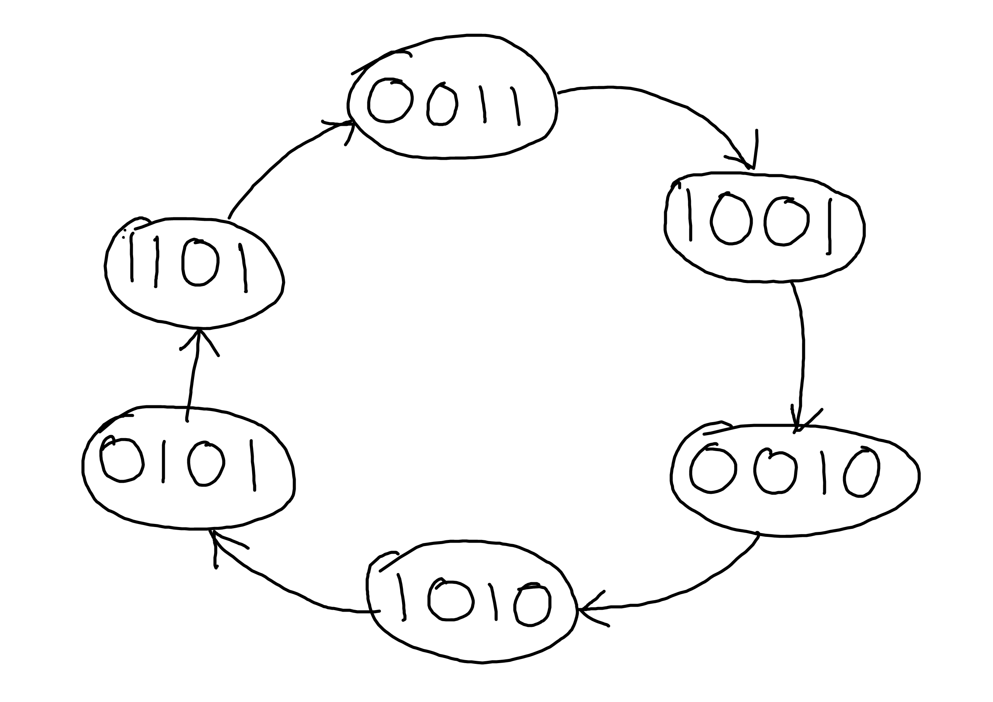
Final Assignment and Test
Written assignment: You need to design a counter. The states you need to display are assigned individually at the end of the slide.
You need to develop the following in the assignment-
State diagram

Slide 3
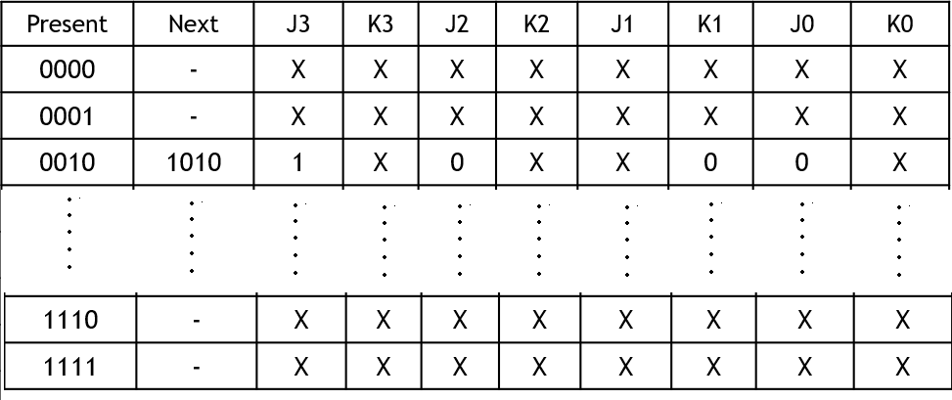
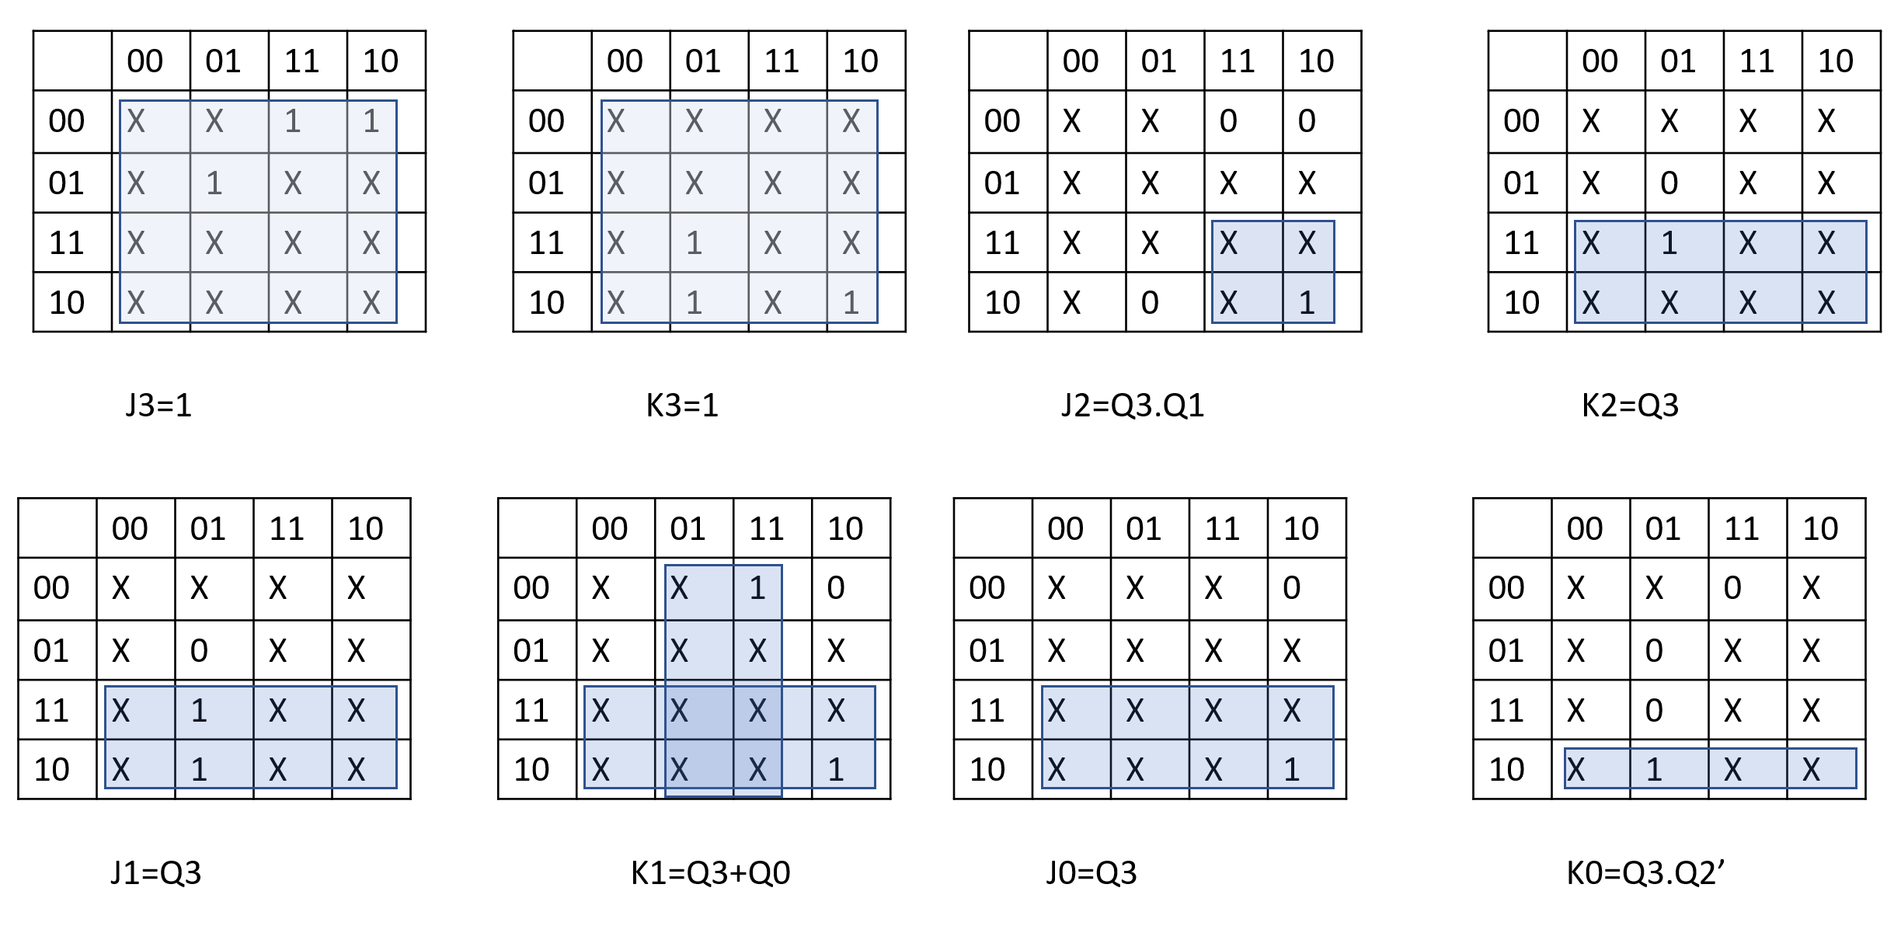
Final Assignment and Test
State table and transition table (mention clearly which flip-flop you’ll be using).
K-map for each flip-flop and the function for each input in terms of outputs.

Slide 4
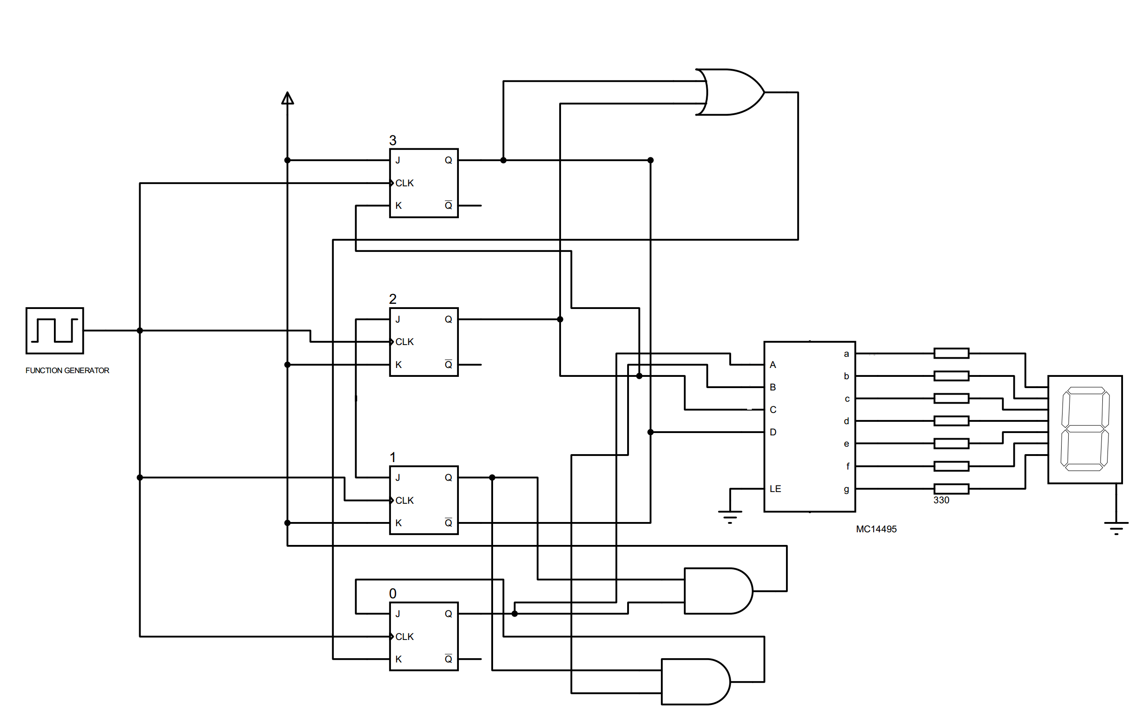
Final Assignment and Test
Schematic diagram of the counter.
Only symbols are fine. No need to show pin numbers.

Slide 5
Final Assignment and Test
Lab task:
Implement your designed circuit in the lab.

Slide 6
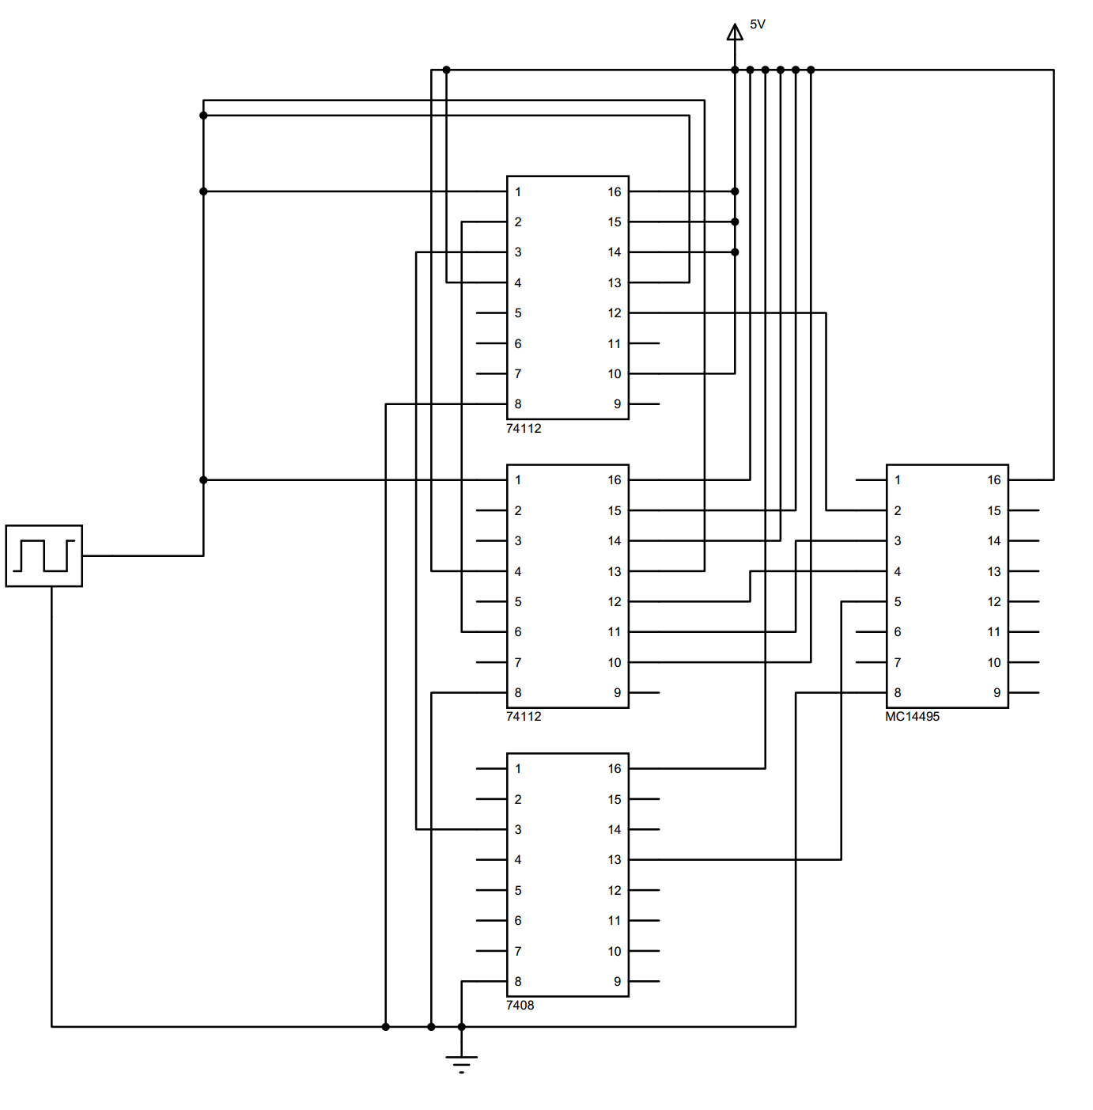
Final Assignment and Test
Important:
If your circuit doesn’t work in the lab, submit a detailed circuit diagram showing the connection for each pin.

Slide 7
Final Assignment and Test
Notes:
1. You can keep a copy of detailed circuit including all connections so that you can follow it while making circuit.
2. Be careful about the ICs you’ll be using. For JK flip-flop, check if it’s 7476 or 74112. For 7-segment display, check for IC 14495 or 9368.

Slide 8
Final Assignment and Test
Lab task:
Common debugging:
1) If the 7-segment display doesn’t light at all, check if the 7-segment driver IC is getting power and ground.
2) If the display doesn’t change values, check if the LE pin of the driver IC is grounded.
Also, check if PR and CLR pins in the flip-flop IC is connected to power.
3) If any segment in the display doesn’t work, you can use an LED to test.

Slide 9
That’s the END !!!!
Best of luck..

Slide 10
Questions?
Notes:
10

