Slide 1
University of Maryland Baltimore County Department of Computer Science and Electrical Engineering CMPE 212 Laboratory (Discussion 12)
Hasib Hasan
ha26@umbc.edu
Edward Hanson
ehanson1@umbc.edu
Ankit Baingane
ankitb1@umbc.edu
Notes:
1

Slide 2
Counters
A digital circuit usually made of flip-flops that can count the input pulse. In other words, it can generate particular outputs (called “states”) with each input clock pulse.
Synchronous: All the flip-flops are fed by a common clock signal and their output changes simultaneously.
Asynchronous: Usually one of the flip-flops is fed by an external clock pulse, others get the clock pulse from output of another flip-flop.
Also called ‘ripple’ counter

Slide 3
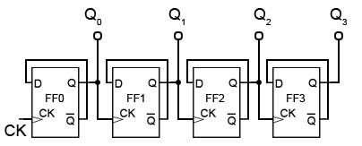
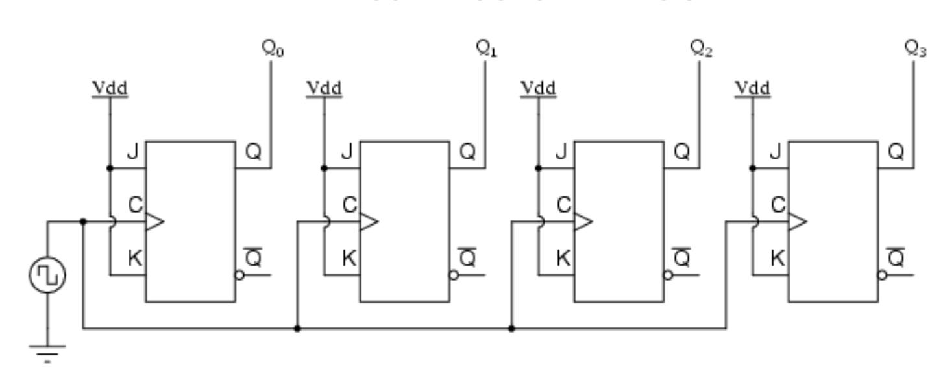
Counters
Asynchronous counter
Synchronous counter

Slide 4
Counters
SYNCHRONOUS COUNTERS | ASYNCHRONOUS COUNTERS
The propagation delay is very low. | Propagation delay is higher than that of synchronous counters.
These are faster than that of ripple counters. | These are slow in operation.
Large number of logic gates are required to design | Less number of logic gates required.
High cost. | Low cost.
Synchronous circuits are easy to design. | Complex to design.
Standard logic packages available for synchronous. | For asynchronous counters, Standard logic packages are not available.

Slide 5
Counters
Commonly used counters:
Decade counter – counts through ten states per stage
Up/down counter – counts both up and down, under command of a control input
Ring counter – formed by a shift register with feedback connection in a ring
Johnson counter – a twisted ring counter
Cascaded counter
Modulus counter.

Slide 6
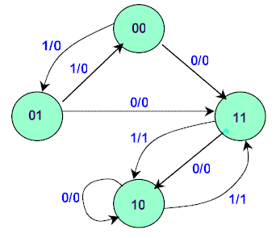
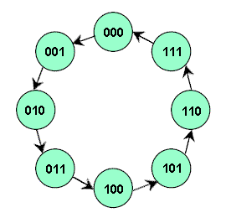
Designing Synchronous Counters
Step 1: Get the State Diagram
We’ll be using this one

Slide 7
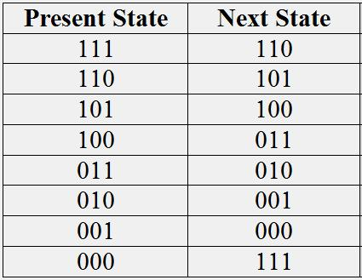
Designing Synchronous Counters
Step 2 : Develop Next-State Table

Slide 8
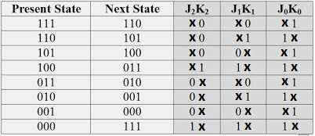
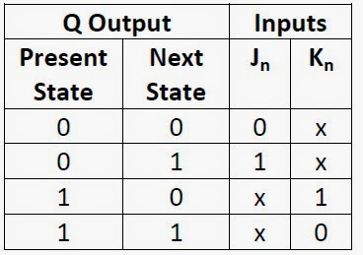
Designing Synchronous Counters
Step 3 : Develop Flip-Flop Transition Table
Choose your Flip-Flop
Use corresponding excitation table
Note that the no. of required flip-flops is the same as the no. of bits in a state.
JK flip-flop excitation table

Slide 9
Designing Synchronous Counters
Step 4 : Develop K-Map from the transition table
 | 0 | 1
00 | 1 | X
01 | 1 | X
11 | 1 | X
10 | 1 | x
 | 0 | 1
00 | X | 1
01 | X | 1
11 | X | 1
10 | X | 1
Jo=1
Ko=1

Slide 10
Designing Synchronous Counters
Step 5 : Realize the circuit from the function

Slide 11
Designing Synchronous Counters
Example: Today’s Lab
Problem: Design a counter that will display the following hexadecimal numbers in the given sequence-
9 > 2 > A > 5 > d > 3

Slide 12
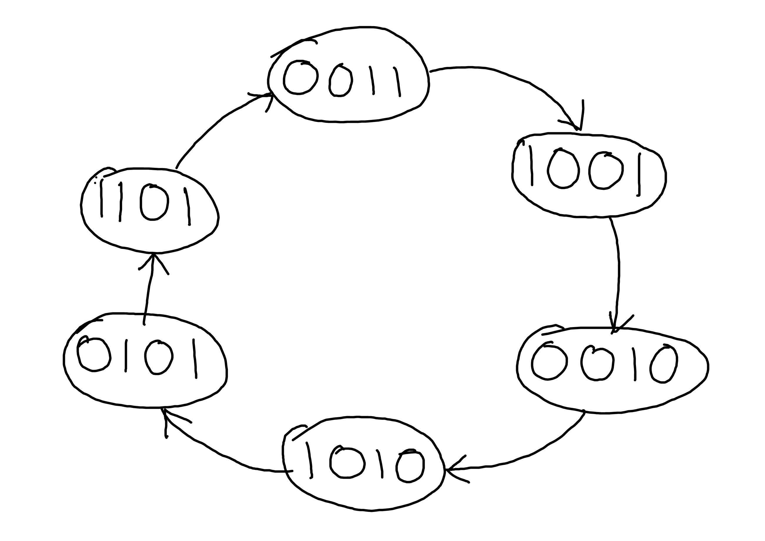
Designing Synchronous Counters
Step 1: Develop the state diagram:
9 > 2 > A > 5 > d > 3

Slide 13
Designing Synchronous Counters
Step 2 and 3: Develop next-state table and transition table: We’ll be using JK flip-flop.
 |  | J3 | K3 | J2 | K2 | J1 | K1 | J0 | K0
0000 | - | X | X | X | X | X | X | X | X
0001 | - | X | X | X | X | X | X | X | X
0010 | 1010 | 1 | X | 0 | X | X | 0 | 0 | X
0011 | 1001 | 1 | X | 0 | X | X | 1 | X | 0
0100 | - | X | X | X | X | X | X | X | X
0101 | 1101 | 1 | X | X | 0 | 0 | X | X | 0
0110 | - | X | X | X | X | X | X | X | X
0111 | - | X | X | X | X | X | X | X | X
1000 | - | X | X | X | X | X | X | X | X
1001 | 0010 | X | 1 | 0 | X | 1 | X | X | 1
1010 | 0101 | X | 1 | 1 | X | X | 1 | 1 | X
1011 | - | X | X | X | X | X | X | X | X
1100 | - | X | X | X | X | X | X | X | X
1101 | 0011 | X | 1 | X | 1 | 1 | X | X | 0
1110 | - | X | X | X | X | X | X | X | X
1111 | - | X | X | X | X | X | X | X | X
State diagram
Excitation table

Slide 14
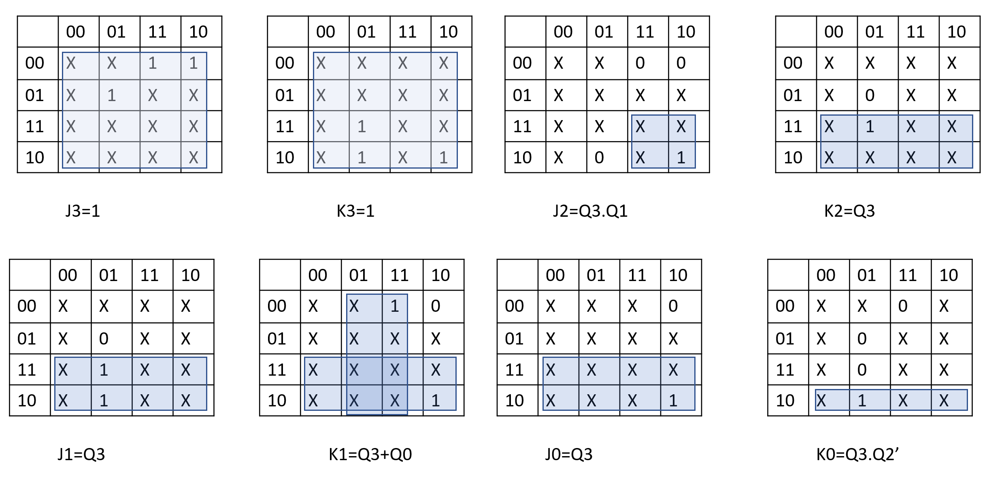
Designing Synchronous Counters
Step 4: Obtain the function for each inputs using K-map.

Slide 15
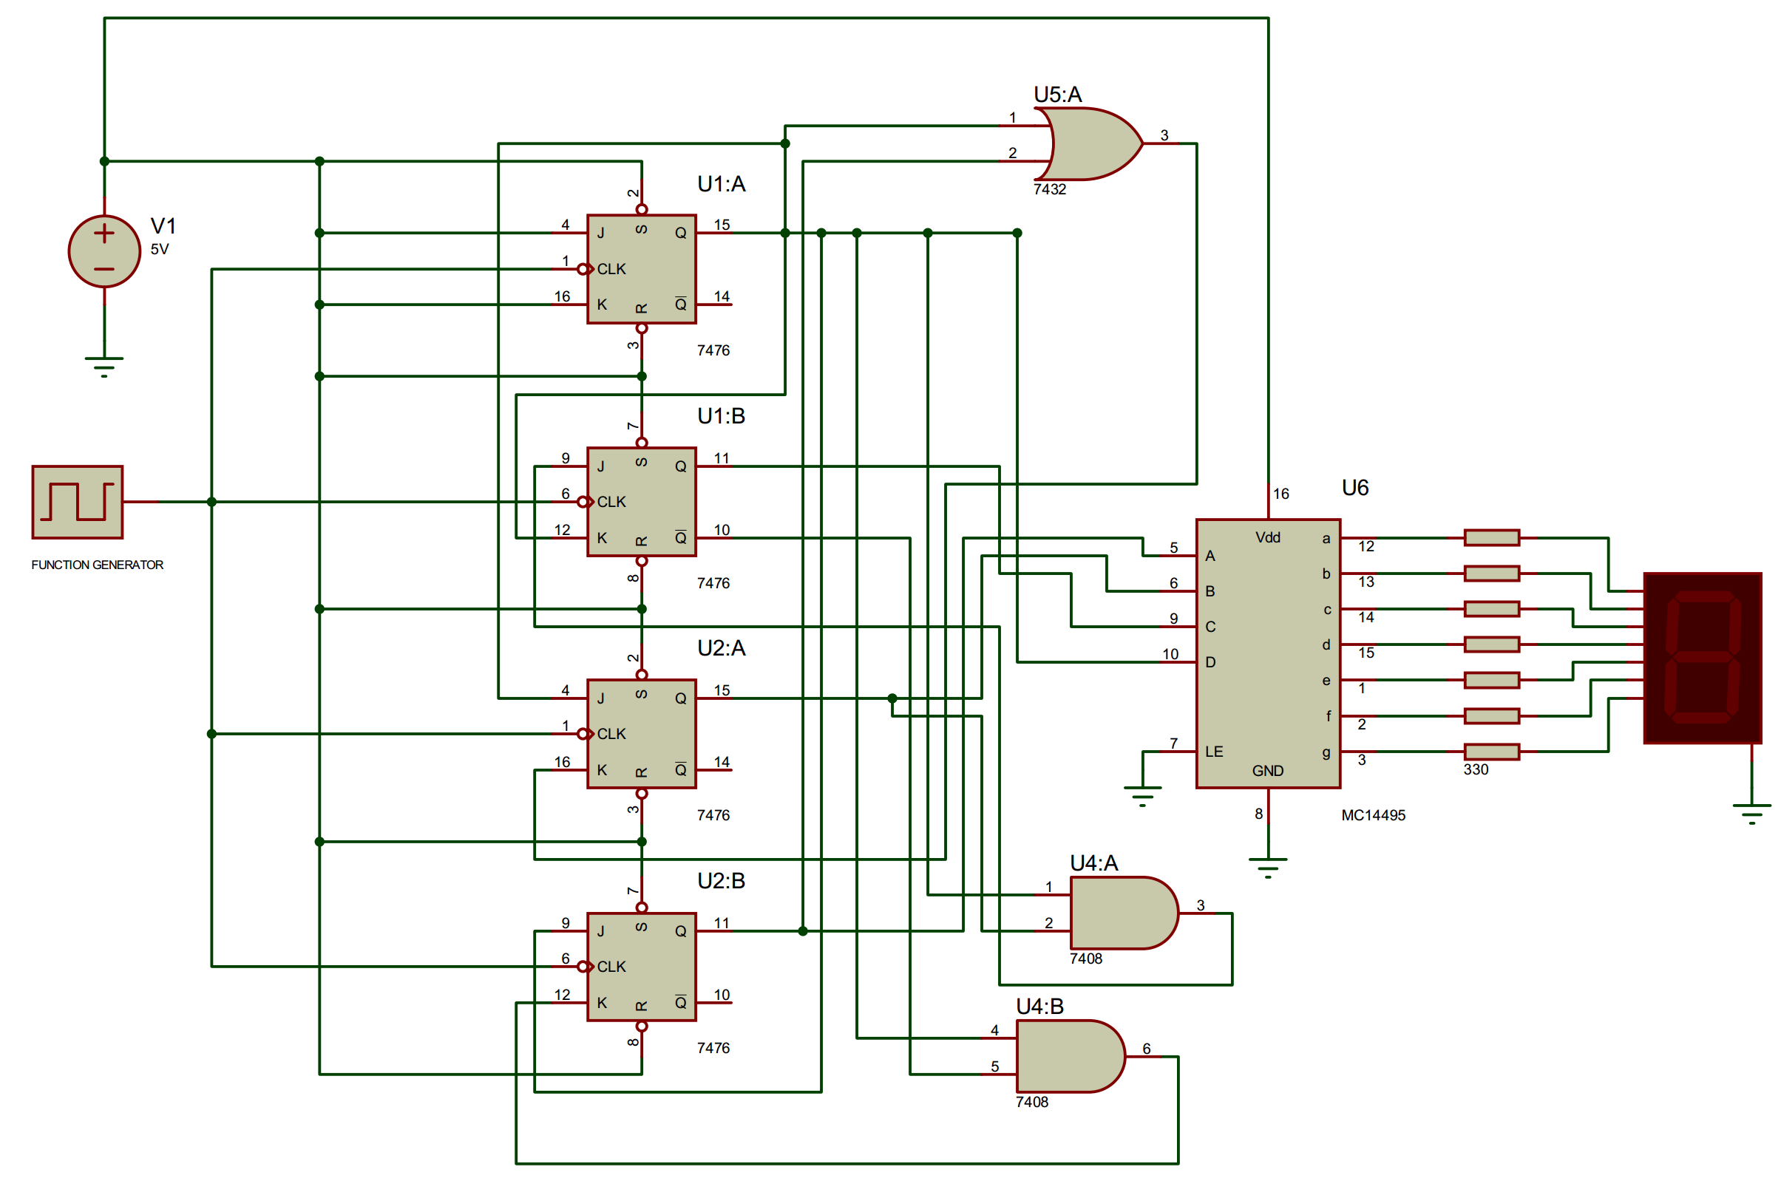
Designing Synchronous Counters
Step 5: Implement the functions in circuit.
We’ll be observing the states in 7-segment display using the decoder IC.

Slide 16
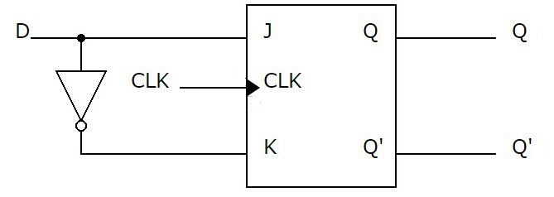
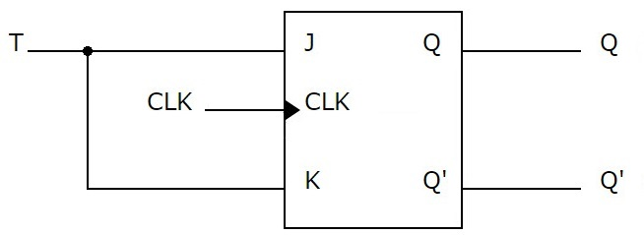
Designing Synchronous Counters
Notes:
You can use any flip-flip e.g. SR, D or T flip-flop to design the counter.
No. of flip-flops to be used is the same as the no. of bits in a state
If you want to use D or T flip-flop, you can use JK flip-flop to implement them as the following-

Slide 17
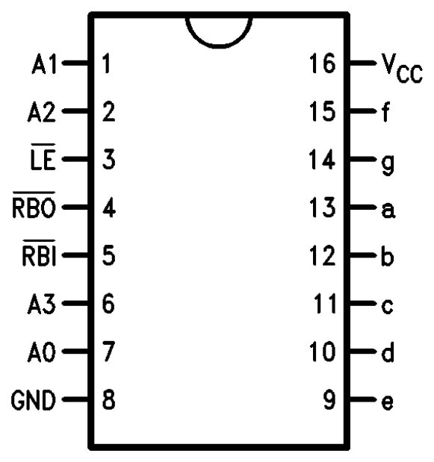
IC 9368 for interfacing the 7-segment display:

Slide 18
Final Assignment and Test
It will carry 25% of the total points for the lab.
It consists of 2 parts-
Written assignment to be submitted at the beginning of the next lab.
You have to make the circuit in lab that you’ll design in the assignment.

Slide 19
Final Assignment and Test
Written assignment: You need to design a counter. The states you need to display are assigned individually at the end of the slide.
You need to develop the following in the assignment-
State diagram
State table and transition table (mention clearly which flip-flop you’ll be using).
K-map for each flip-flop and the function for each input in terms of outputs.
Full circuit diagram of the counter.
ii)

Slide 20
Final Assignment and Test
Lab task:
Implement your designed circuit in the lab.
Notes:
1. Keep a copy of your designed circuit in the lab so that you can follow it while making circuit.
2. Be careful about the ICs you’ll be using. For JK flip-flop, check if it’s 7476 or 74112. For 7-segment display, check for IC 14495 or 9368.
3. If your circuit doesn’t work in the lab, submit a detailed circuit diagram showing the connection for each pin. You’ll get most of your points.

Slide 21
Questions?
Notes:
21

Slide 22
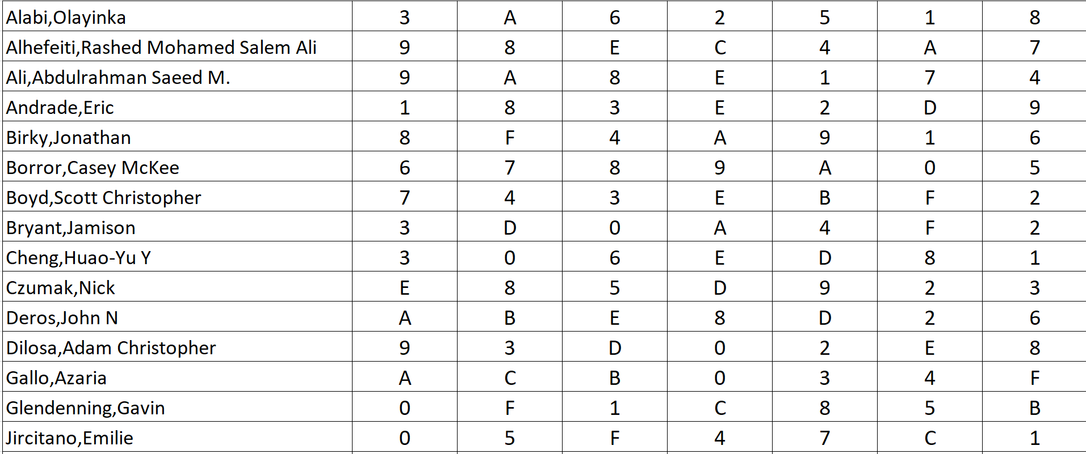
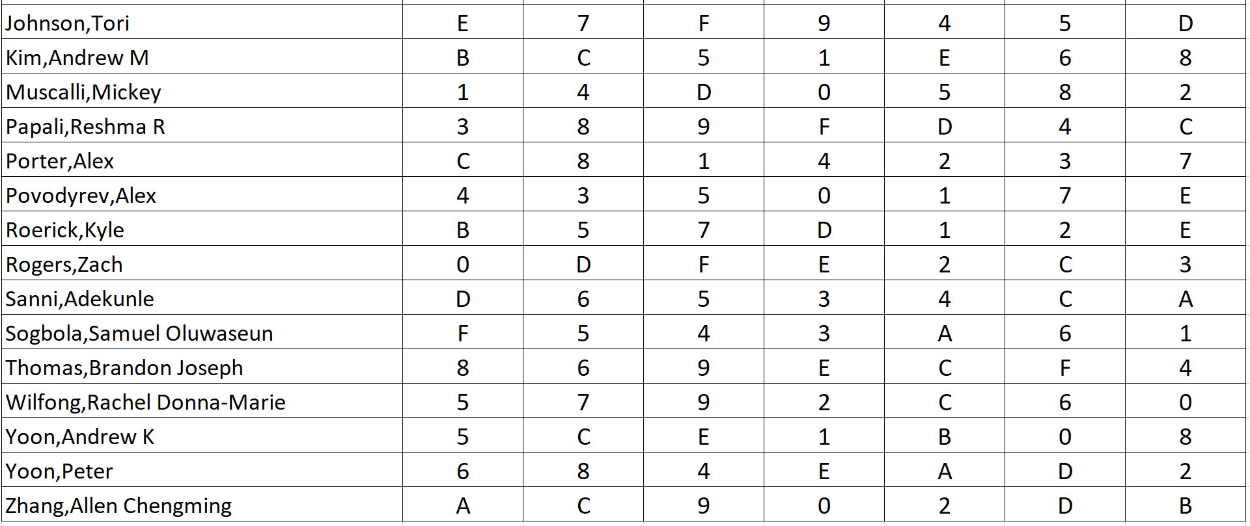

Slide 23
