Slide 1
University of Maryland Baltimore County Department of Computer Science and Electrical Engineering CMPE 212 Laboratory (Discussion 11)
Hasib Hasan
ha26@umbc.edu
Edward Hanson
ehanson1@umbc.edu
Ankit Baingane
ankitb1@umbc.edu
Notes:
1

Slide 2
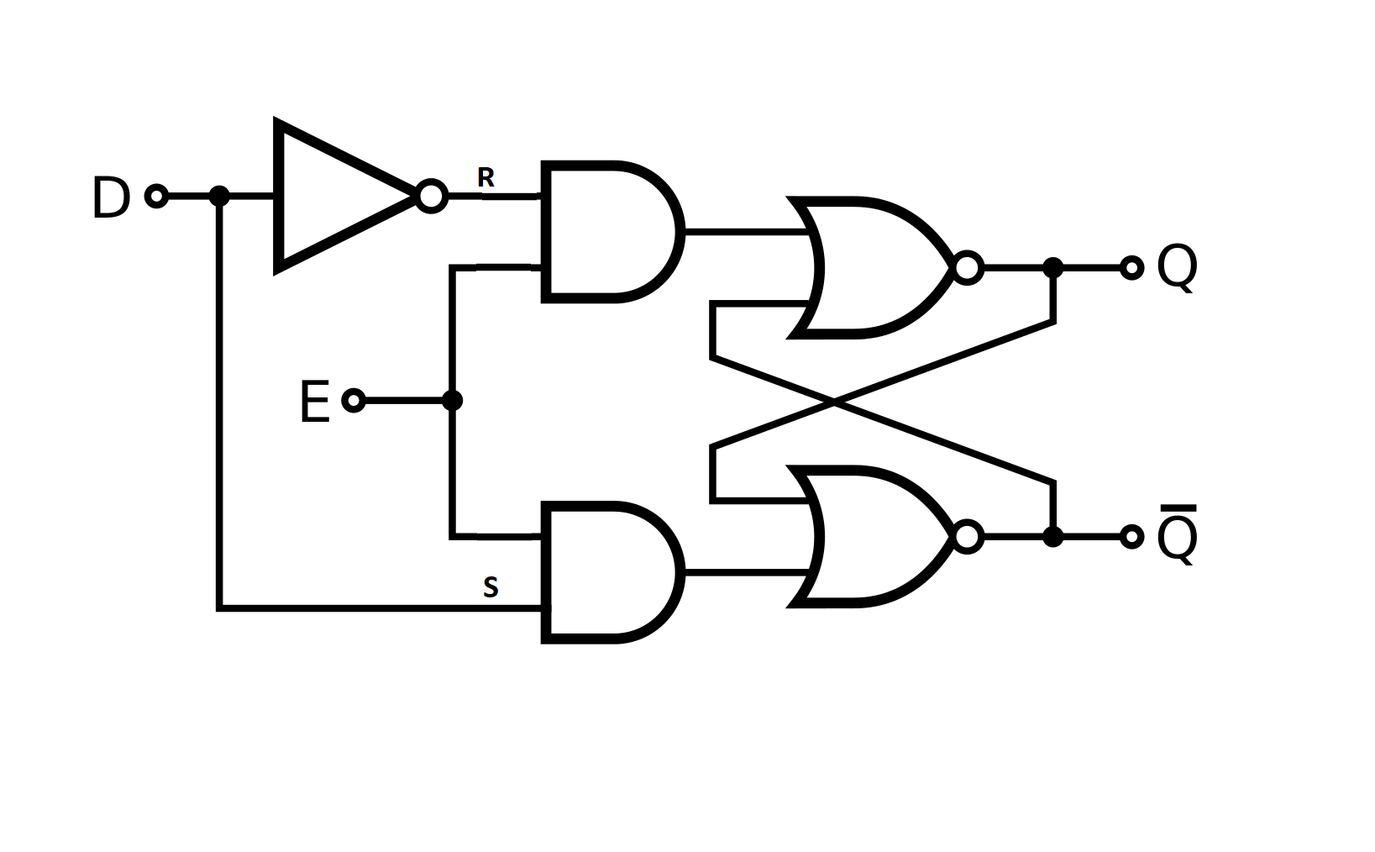
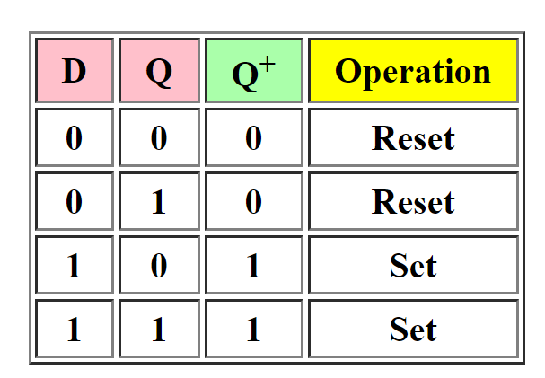
More Latches and Flip-Flops
D Latch:
Has only one input, called “D”
Output is the same as the input.
The simplest structure could be an S-R latch with S and R connected through an inverter and taking S as the D input.
Characteristic table

Slide 3
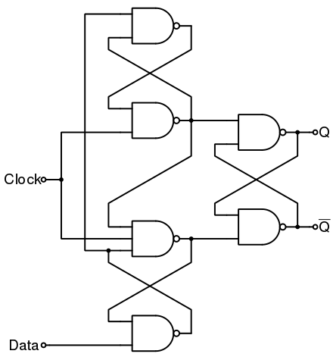
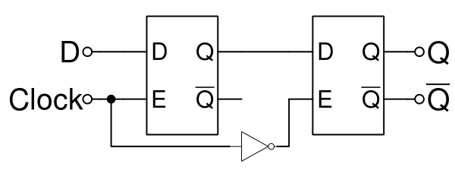
More Latches and Flip-Flops
Edge triggered D Flip-Flop:
falling-edge triggered Master-Slave D Flip-Flop
rising-edge triggered D Flip-Flop

Slide 4
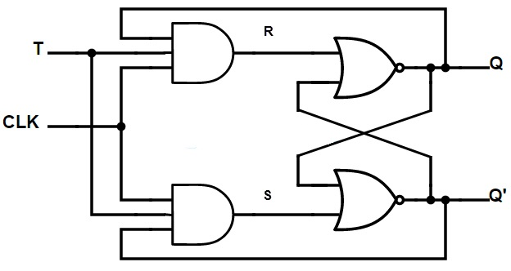
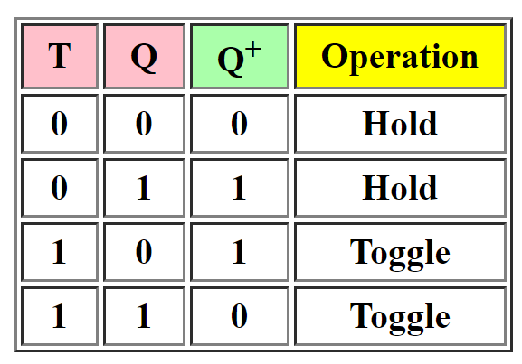
More Latches and Flip-Flops
T Flip-Flop:
Has only one input, called “T”
If ‘T’ is LOW, the output holds the state.
If ‘T’ is HIGH, the output toggles.
Characteristic table

Slide 5
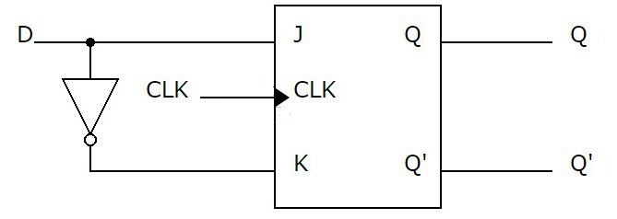
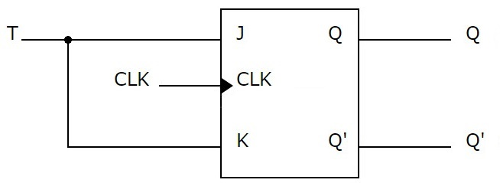
More Latches and Flip-Flops
‘D’ and ‘T’ Flip-Flop using J-K Flip Flop:
D Flip-Flop with J-K Flip-Flop
T Flip-Flop with J-K Flip-Flop

Slide 6
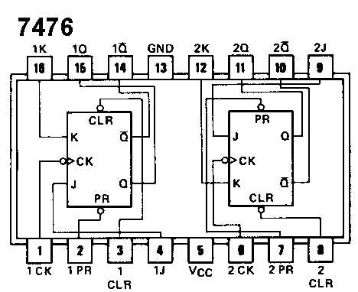
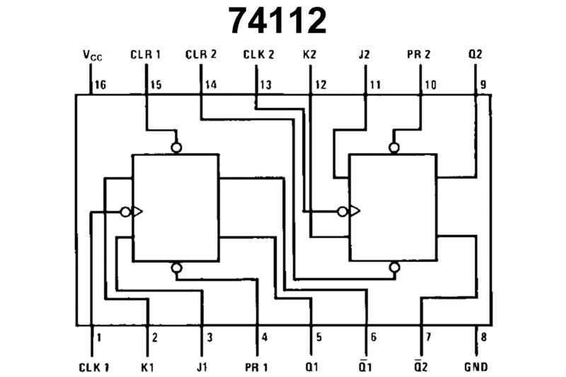
More Latches and Flip-Flops
J-K Flip-Flop IC pinout diagram:

Slide 7
Timing Diagram
A digital timing diagram is a representation of a set of signals in the time domain.
We can represent the Flip-Flops using their timing diagram-
Normally, one of the signals is the clock signal.
Other signals are the inputs and the outputs.
The relation between the input and the output can be determined.
The triggering characteristics can also be known-
Level triggered or edge triggered.
Rising or falling edge triggered.

Slide 8
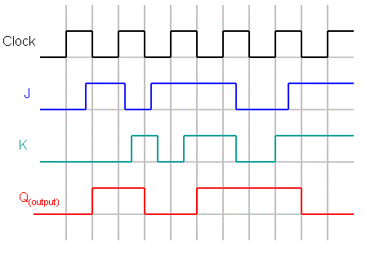
Timing Diagram
Example:
Timing diagram of a falling edge triggered JK flip-flop

Slide 9
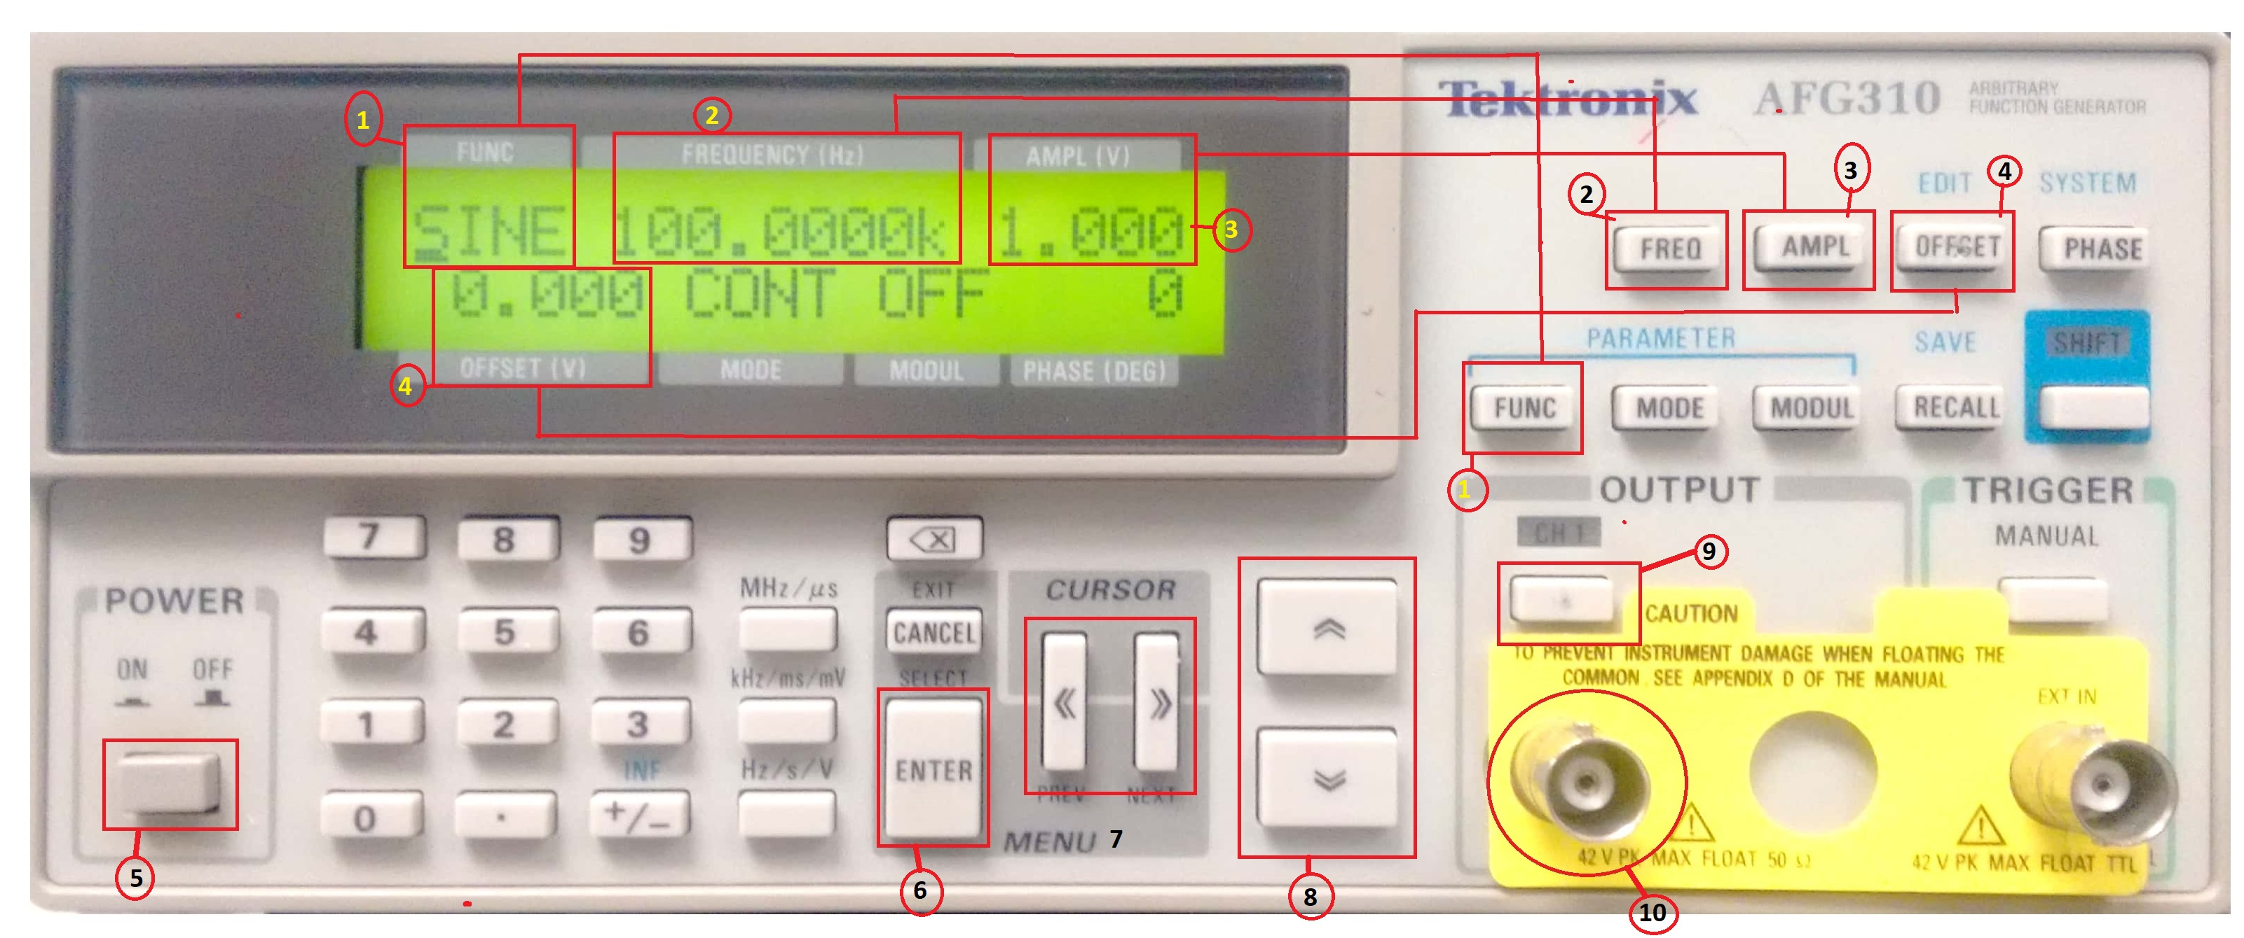
Generating Clock Pulse
We’ll use our function generator in the lab to generate the clock pulse.

Slide 10
Type of the signal (sine/square/triangular/DC/Pulse etc.)
Frequency of the signal
Amplitude (from zero to peak value)
Offset (shifts the position of the reference)
Power button
Enter (saves a value)
Shifts the cursor
Increase/Decrease values
Switching the output on/off
Output

Slide 11
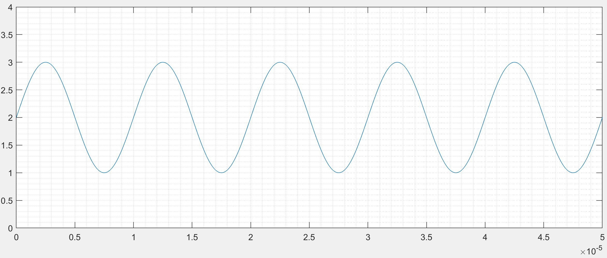
Generating Clock Pulse
So, if -
‘func’ is ‘SINE’,
‘amplitude’ is ‘1’,
‘frequency’ is ‘100kHz’, and
‘offset’ is ‘1’
We’ll have the following output-

Slide 12
Generating Clock Pulse
To set a value-
Press the corresponding button
Use cursor and up/down button, or the numeric pad to set a value.
Press the ‘enter’ button to save the value.
Repeat this for every parameter you want to set.

Slide 13
Generating Clock Pulse
For our experiments we need the following clock pulse-
Set the ‘func’ to ‘SQUARE’
Set ‘frequency’ to ‘1 Hz’
Set ‘amplitude’ to ‘2.5’
Set ‘offset’ to ‘1.25’

Slide 14
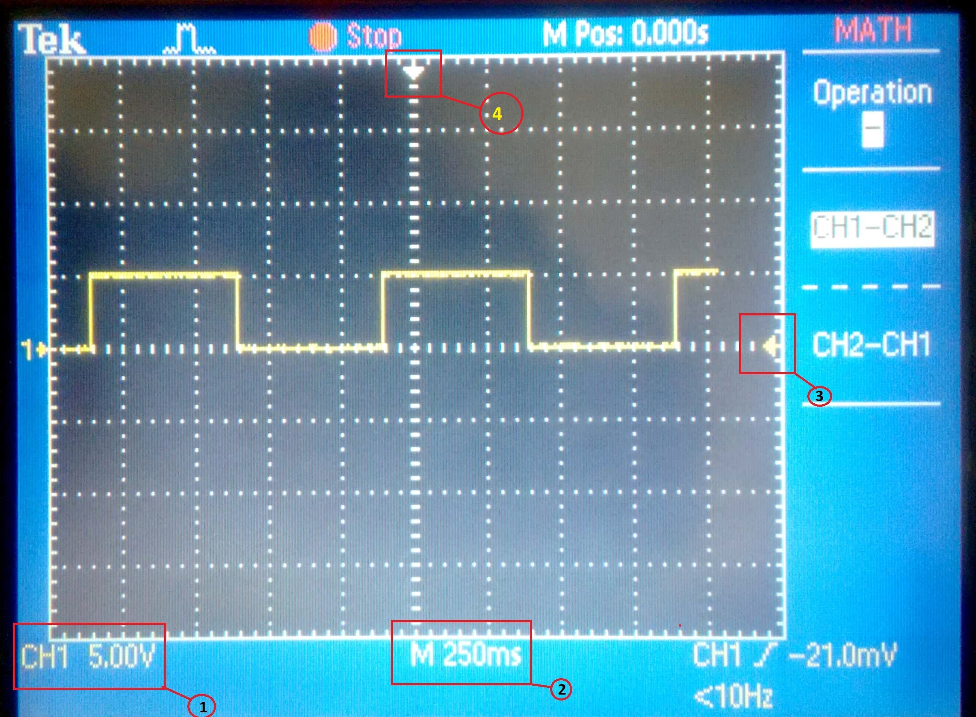
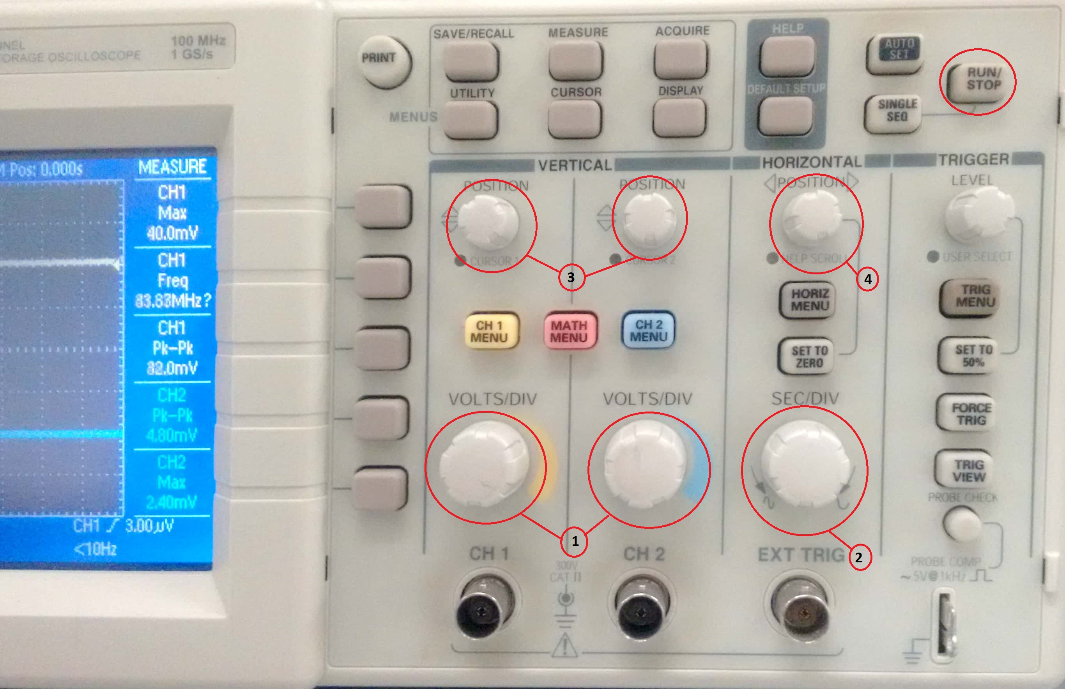
Oscilloscope as Output
Oscilloscope can generate the timing diagram precisely.
volts/division (y-axis)
second/division (x-axis)
X-axis position
Y-axis position

Slide 15
7-Segment Display Driver
Finding the function and then implement the logic for each segment was tedious.
We’ll be using IC MC14495 to drive our display.
It gives the necessary output to drive a 7-segment display and shows the Hexadecimal value from the 4-bit Binary input.

Slide 16
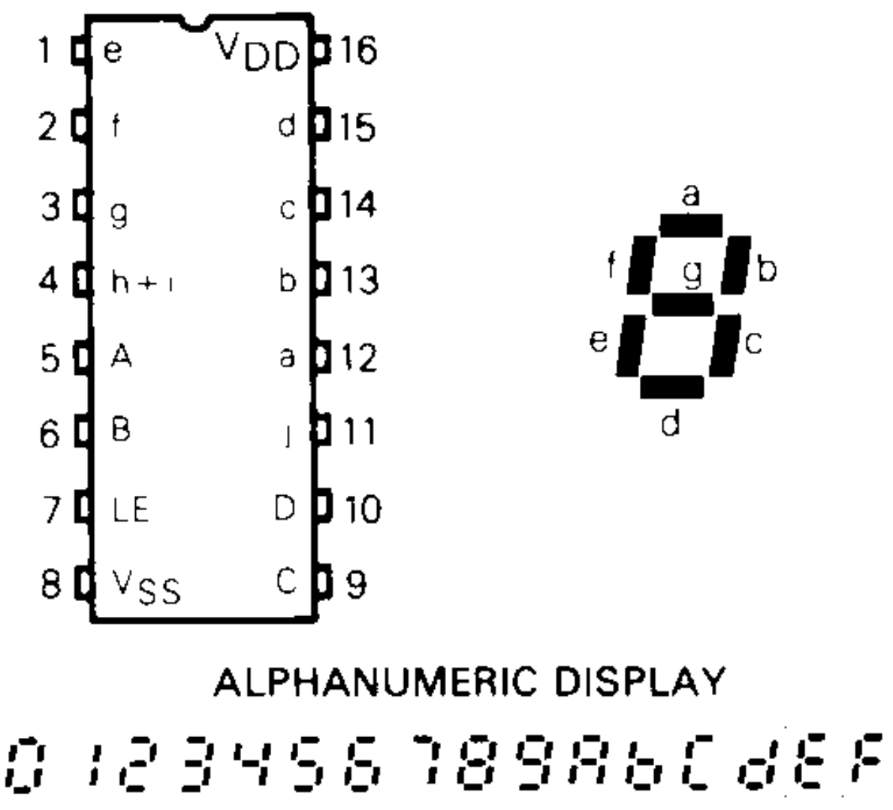
7-Segment Display Driver
MC14495

Slide 17
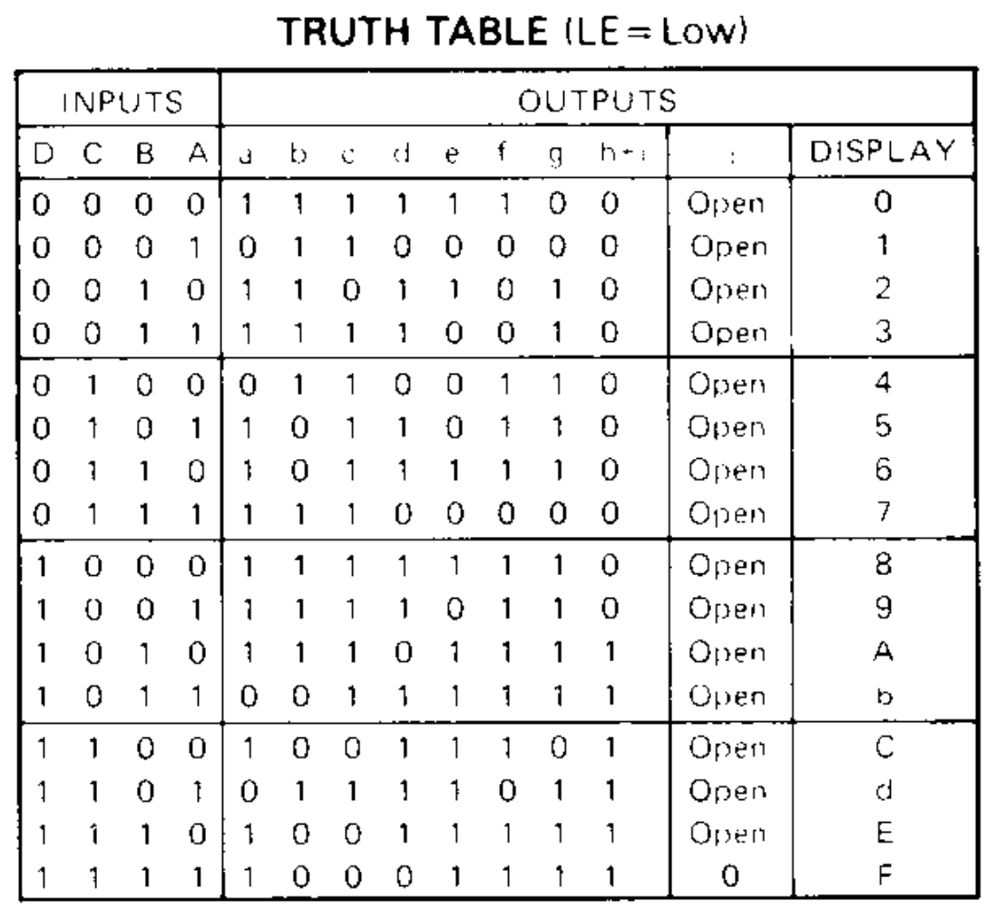
7-Segment Display Driver
MC14495
Truth Table

Slide 18
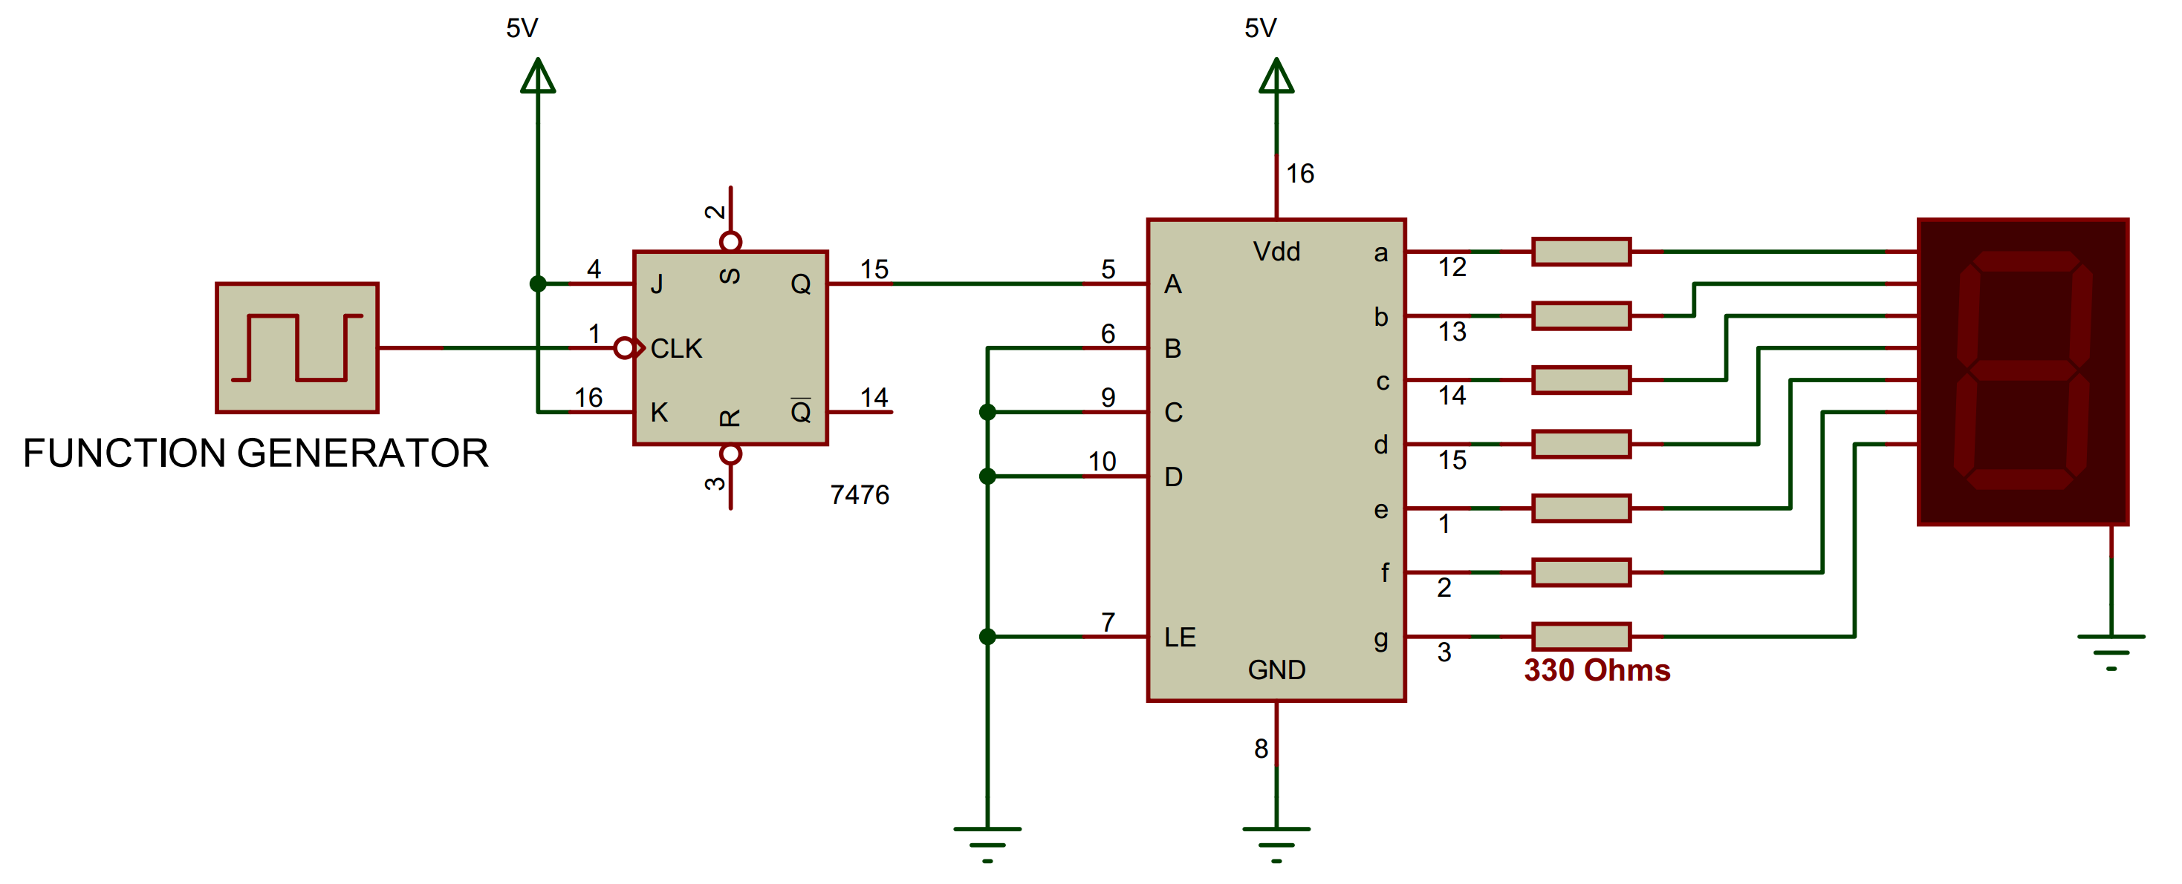
Today’s Lab (last part)
1.You need to set the function generator to get our desired clock signal
2.Make a T flip-flop using the JK flip-flop. So, it will give only ‘0’ and ‘1’ with the clock signal.
3. This signal will be fed to input ‘A’ of the MC14485 IC. Other inputs will be grounded. So, it will have the input ‘0000’ and ‘0001’. So, the display will show ‘0’ and ‘1’ alternately.

Slide 19
Questions?
Notes:
19

