Slide 1
University of Maryland Baltimore County Department of Computer Science and Electrical Engineering CMPE 212 Laboratory (Discussion 10)
Hasib Hasan
ha26@umbc.edu
Edward Hanson
ehanson1@umbc.edu
Ankit Baingane
ankitb1@umbc.edu
Notes:
1

Slide 2
Sequential Logic
A type of logic circuit whose output depends not only on the present value of its input signals but also on the sequence of past inputs. Meaning, it can store a binary data.
For example: TV remote.
Applications:
In counter , shift register, flip-flops
Processor and computing units
Memory units- RAM , SSD.
Programmable devices (Microcontrollers, PLDs, FPGA, CPLDs)

Slide 3
Basic Sequential Logic Circuit
S-R Latch (NOR):
Characteristic table
S | R | Q_{next} | Action
0 | 0 | Q | hold state
0 | 1 | 0 | reset
1 | 0 | 1 | set
1 | 1 | X | not allowed

Slide 4
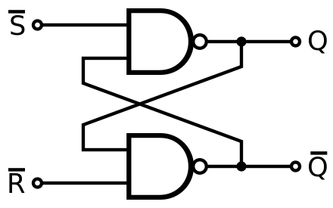
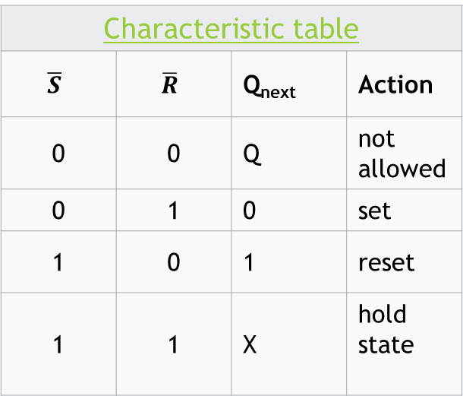
Basic Sequential Logic Circuit
S-R Latch (NAND):
Characteristic table
$$\overline{S}$$ | $$\overline{R}$$ | Q_{next} | Action
0 | 0 | Q | not allowed
0 | 1 | 0 | set
1 | 0 | 1 | reset
1 | 1 | X | hold state

Slide 5
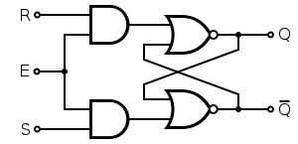
Fetching the Output from the Latch
You need to get the output when it’s desired.
You can make a provision for enabling or disabling your latch circuit.
The R and S works only when E is HIGH.
It’s called “Gated” latch or “Level Triggered” latch.
Also “asynchronous”

Slide 6
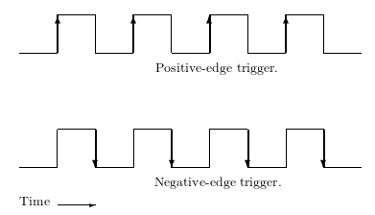
Fetching the Output from the Latch
Or, you can use a clock signal in place of Enable:
It’s synchronous: Goes to HIGH and LOW at a fixed interval of time.
It could be edge triggered: The circuit will operate only when the clock signal changes from ‘0’ to ‘1’ or, ‘1’ to ‘0’.

Slide 7
Latch vs. Flip-Flop
The first case, the circuit without any synchronous clock signal is a latch.
May or may not have enable.
When it has a synchronous clock signal, it’s called a Flip-Flop
In general, they’re always edge triggered.

Slide 8
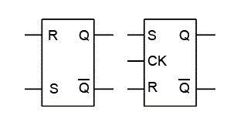
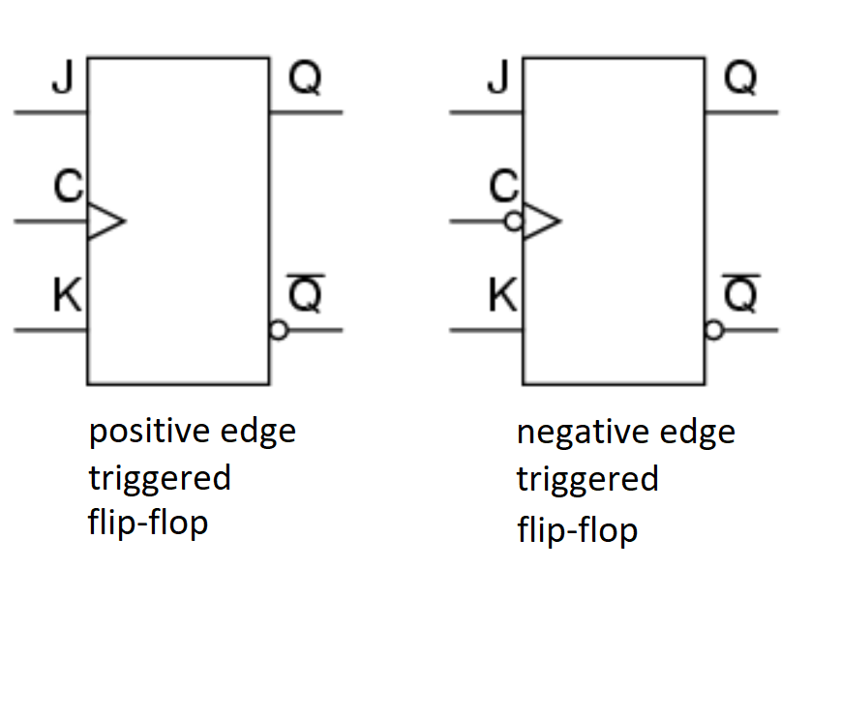
Symbols:
simple latch
clocked latch

Slide 9
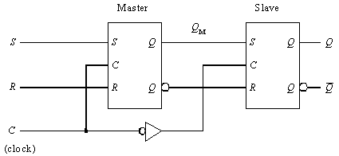
Master-Slave Flip-Flop
Different configurations are possible for implementing a Flip-Flop.
Master-Slave configuration is one of the commonly used ones.
Consists of two identical RS latch circuits
The inverter connected between the two CLK inputs ensures that the two sections will be enabled during opposite half-cycles of the clock signal. This is the key to the operation of this circuit.

Slide 10
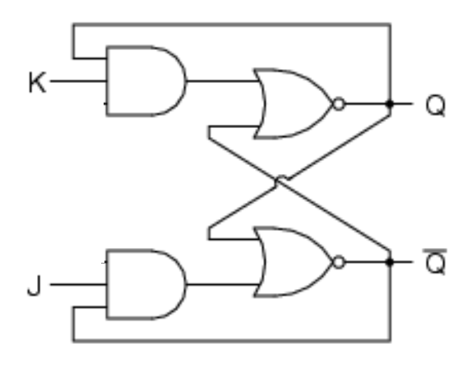
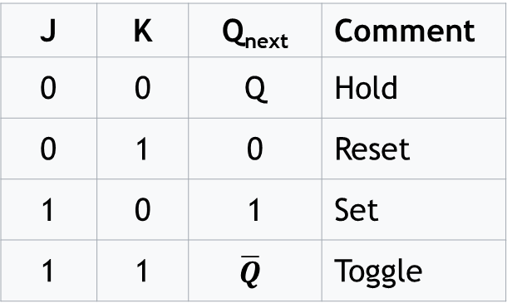
JK Latch
Was developed to overcome the problem in “not allowed” inputs of an S-R Latch.
Now, we have made that “not allowed” input to toggle the previous output.
J | K | Q_{next} | Comment
0 | 0 | Q | Hold
0 | 1 | 0 | Reset
1 | 0 | 1 | Set
1 | 1 | $$\overline{Q}$$ | Toggle

Slide 11
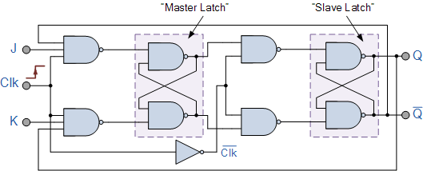
Master-Slave JK Flip-Flop
When j =1, k = 1 and clk = 1; Q output will toggle as long as CLK is high. Thus the output will be unstable with continuously changing from HIGH to LOW. This problem is called race-around.
Race-around problem can be solved by adopting the master-slave configuration called Master-Slave J-K flip-flop.
Output will only change with the trigger.

Slide 12
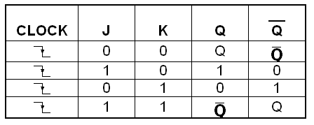
Master-Slave JK Flip-Flop
Characteristic table:

Slide 13
Characteristic table vs Excitation table
Characteristic table: Tells you the next output state for a given set of inputs and present output state.
Excitation table: Tells you what should be your inputs for a desired output in the next state.
You’ll be needing them a lot in designing counters and other sequential logic circuits.

Slide 14
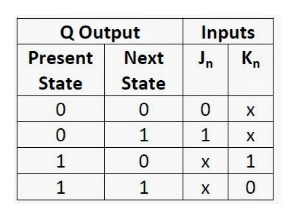
Master-Slave JK Flip-Flop
Excitation table:

Slide 15
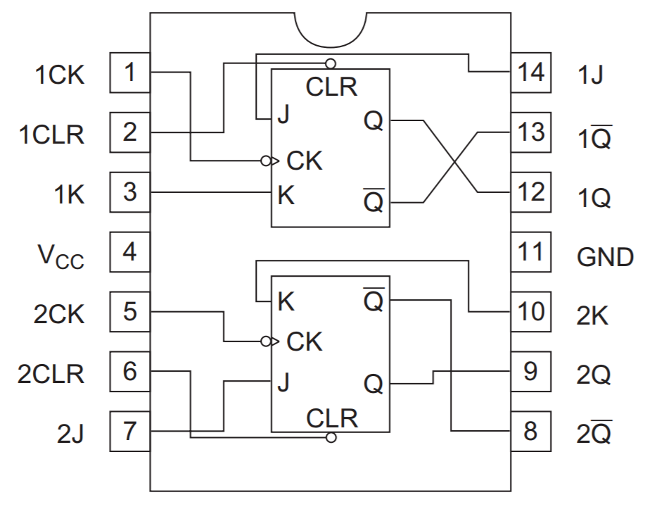
Master-Slave JK Flip-Flop IC
IC 7476:

Slide 16
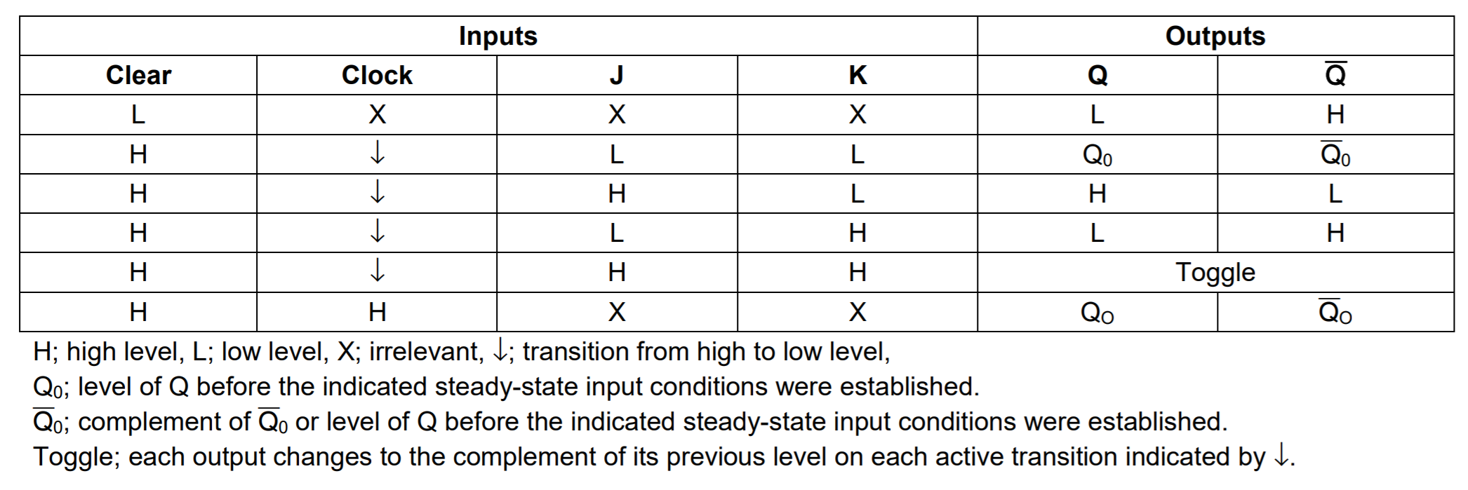
Master-Slave JK Flip-Flop IC
IC 7476 Characteristic table:

Slide 17
Questions?
Notes:
17

