Slide 1
University of Maryland Baltimore County Department of Computer Science and Electrical Engineering CMPE 212 Laboratory (Discussion 8)
Hasib Hasan
ha26@umbc.edu
Edward Hanson
ehanson1@umbc.edu
Ankit Baingane
ankitb1@umbc.edu
Notes:
1

Slide 2
Lab assignment due today !!!
You’ll be given problems similar to Lab 07.
You need to display required number / letter/ character according to the given conditions.
Make truth table for each segment from the given conditions.
Find the expressions for each segment from the truth table using K-map or any other technique.
Build your circuit and display the characters for different input conditions as described by the problem.

Slide 3
Interfacing 7-segment display
Attention !!!
Please use separate RESISTORS in series before each segment.
Use resistors of 1k or 330 Ohms.

Slide 4
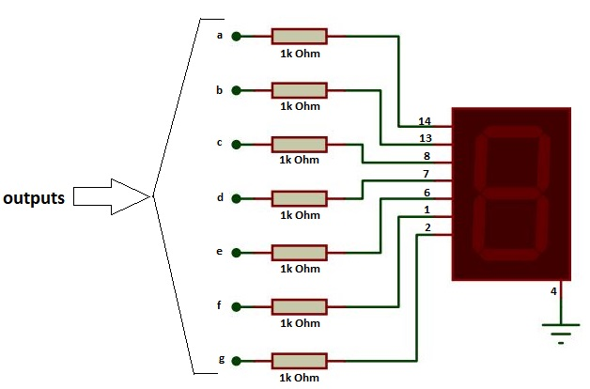
Interfacing 7-segment display

Slide 5
Interfacing 7-segment display
Attention !!!
NEVER test your LED / 7-segment display by connecting to the power.
Use your Multimeter to check if they’re working.
Take your dial to continuity/diode mode.
Connect the Black lead of the multimeter to pin no. 4 or 12 and the Red lead to other pins.
If the segment lights up or the multemeter displays a value, it’s working.

Slide 6
Interfacing 7-segment display
Pro tip:
Don’t connect any pin of the display directly to the DIP switch with/without a resistor.
Example: f = A

Slide 7
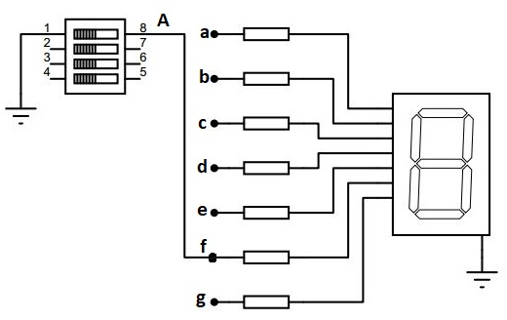
Interfacing 7-segment display
What you would like to do:
f=A

Slide 8
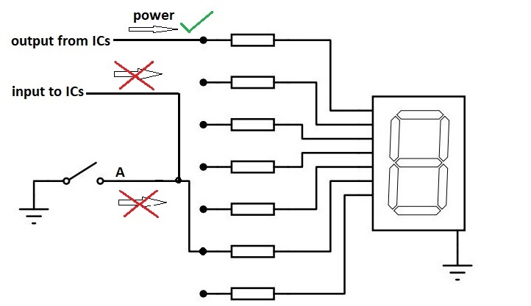
Interfacing 7-segment display
Problem:
The DIP switch doesn’t supply power to the display like the ICs do. So, it won’t work at all.

Slide 9
Interfacing 7-segment display
What you need to do:
Use the logic A.A=A or A+A=A or $\overline{\overline{A}}=A$
This way, the output comes from an IC that can supply power to the display.

Slide 10
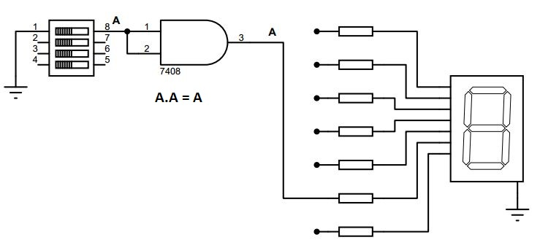
Interfacing 7-segment display
f=A

Slide 11
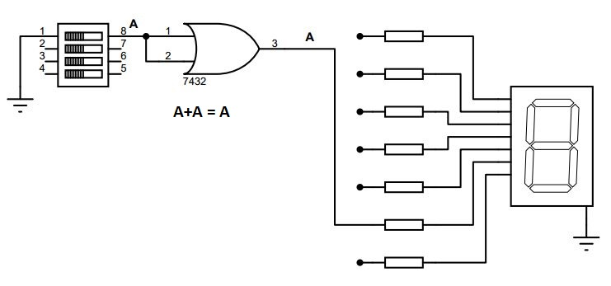
Interfacing 7-segment display
f=A

Slide 12
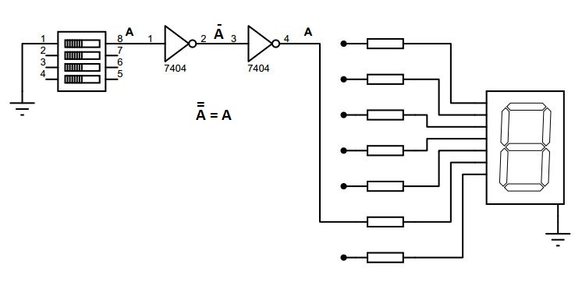
Interfacing 7-segment display
f=A

Slide 13
Interfacing 7-segment display
Other notes:
Refer to all previous slides for the IC pinouts and debugging of the circuit.
Don’t give power supply before completing the circuit.
Check again for the 7-segment displays if they’re connected to a resistor.

Slide 14
Questions?
Notes:
14

Slide 15
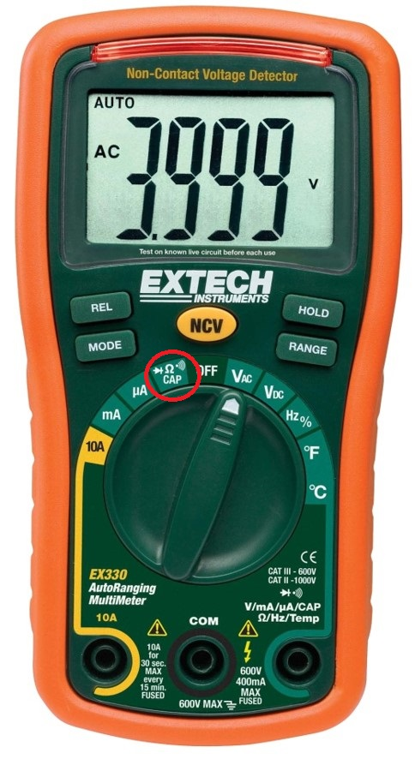
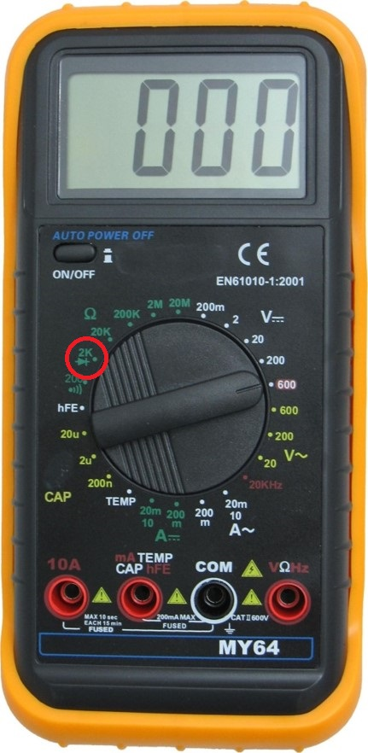
Notes:
15

