Slide 1
University of Maryland Baltimore County Department of Computer Science and Electrical Engineering CMPE 212 Laboratory (Discussion 7)
Hasib Hasan
ha26@umbc.edu
Edward Hanson
ehanson1@umbc.edu
Ankit Baingane
ankitb1@umbc.edu
Notes:
1

Slide 2
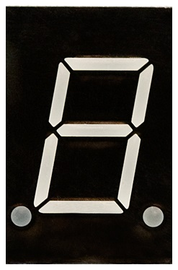
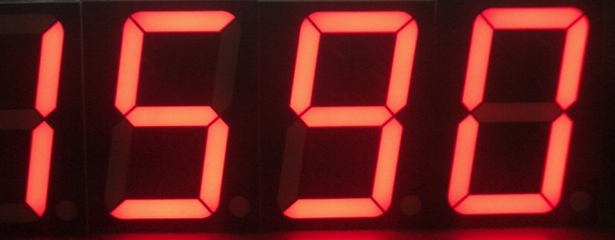
7-segment display

Slide 3
7-segment display
Seven-segment displays are commonly used in digital clocks, clock radios, timers, wristwatches, and calculators.
They can also be found in motor-vehicle odometers, speedometers, radio frequency indicators, and practically any other display that makes use of alphanumeric characters alone (without the need for graphics).

Slide 4
7-segment display
A set of seven bar-shaped LED (light-emitting diode) or LCD(liquid crystal display) elements, arranged to form a squared-off figure 8.
A few other seven-segment displays use other illumination devices, such as incandescent or gas-plasma ("neon") lamps.
If all elements are activated, the display shows a numeral 8.
When some of the elements are activated but not others, any single-digit numeral from 0 to 9, as well as most uppercase and lowercase letters of the English alphabet, can be portrayed.

Slide 5
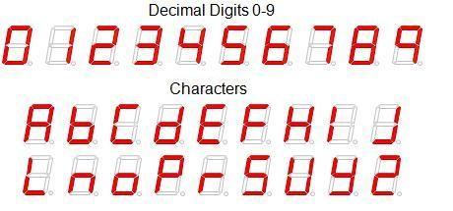
7-segment display

Slide 6
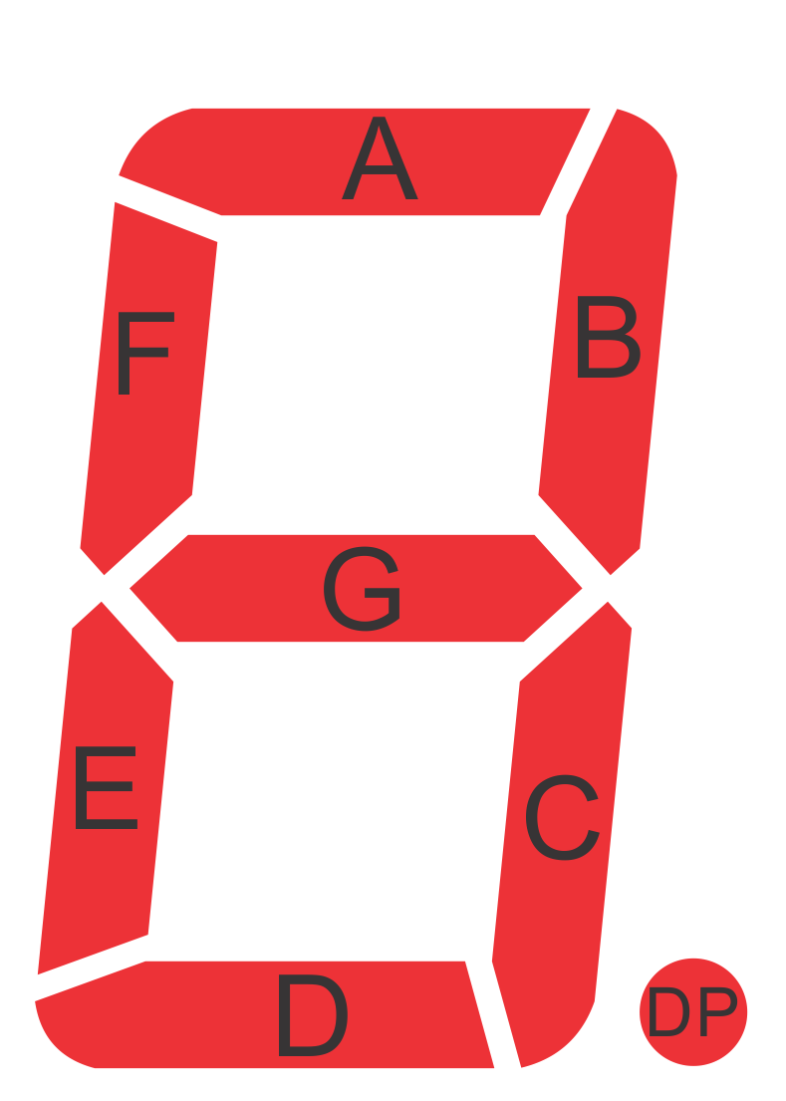
7-segment display
Each one of the seven LEDs in the display is given a positional segment with one of its connection pins being brought straight out of the rectangular plastic package.
These individual LED pins are labelled from ’a’ through to ’g’ representing each individual LED. The other LED pins are connected together and wired to form a common pin.
By forward biasing the appropriate pins of the LED segments in a particular order, some segments will be light and others will be dark allowing the desired character pattern of the number to be generated on the display.

Slide 7
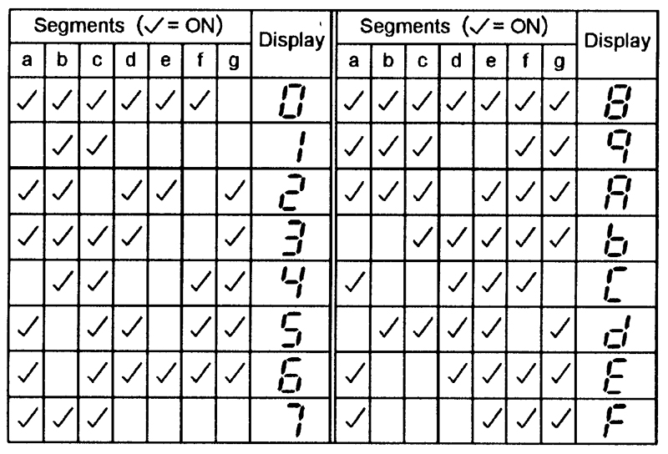
7-segment display
Segments to be made ON to show the characters:

Slide 8
7-segment display connections
The displays common pin is generally used to identify which type of 7-segment display it is. As each LED has two connecting pins, one called the “Anode” and the other called the “Cathode”, there are therefore two types of LED 7-segment display called: Common Cathode (CC) and Common Anode (CA).

Slide 9
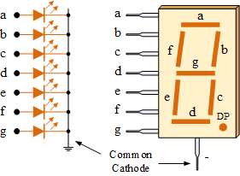
7-segment display connections
Common Cathode:
In the common cathode display, all the cathode connections of the LED segments are joined together to logic “0” or ground. The individual segments are illuminated by application of a “HIGH”, or logic “1” signal via a current limiting resistor to forward bias the individual Anode terminals (a-g).

Slide 10
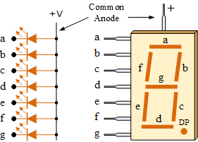
7-segment display connections
Common Anode:
The Common Anode (CA) – In the common anode display, all the anode connections of the LED segments are joined together to logic “1”. The individual segments are illuminated by applying a ground, logic “0” or “LOW” signal via a suitable current limiting resistor to the Cathode of the particular segment (a-g).

Slide 11
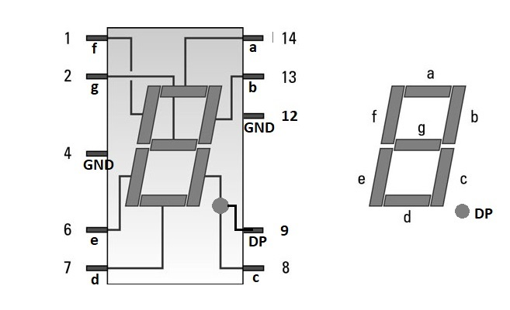
7-segment display connections
Your 7-segment display:
It’s a common cathode 7-segment display.
It comes in DIP package. The pinout is as follows-

Slide 12
Interfacing 7-segment display
You can consider each segment as individual outputs.
So, you need separate expressions for each of the 7 segments.
Make truth table for each of the segments.
Use K-map or Boolean algebra to find the expression for each segment

Slide 13
Interfacing 7-segment display
Example:
## let’s make a circuit that has only one bit input. If the input is 0, the 7-segment segment display will display ‘’0’’. If the input is 1, it will display the digit ‘’1’’
Firstly, find out the truth table for each of the segments:
Input (A) | a | b | c | d | e | f | g
0 | 1 | 1 | 1 | 1 | 1 | 1 | 0
1 | 0 | 1 | 1 | 0 | 0 | 0 | 0

Slide 14
Interfacing 7-segment display
Then find out the expression for each segment from the truth table-
Input (A) | a | b | c | d | e | f | g
0 | 1 | 1 | 1 | 1 | 1 | 1 | 0
1 | 0 | 1 | 1 | 0 | 0 | 0 | 0
Here, we have only one input variable. So, we can use simple Boolean algebra.
This leads to-
a= Ã; b= 1; c= 1; d = Ã; e = Ã; f = Ã; g= 0

Slide 15
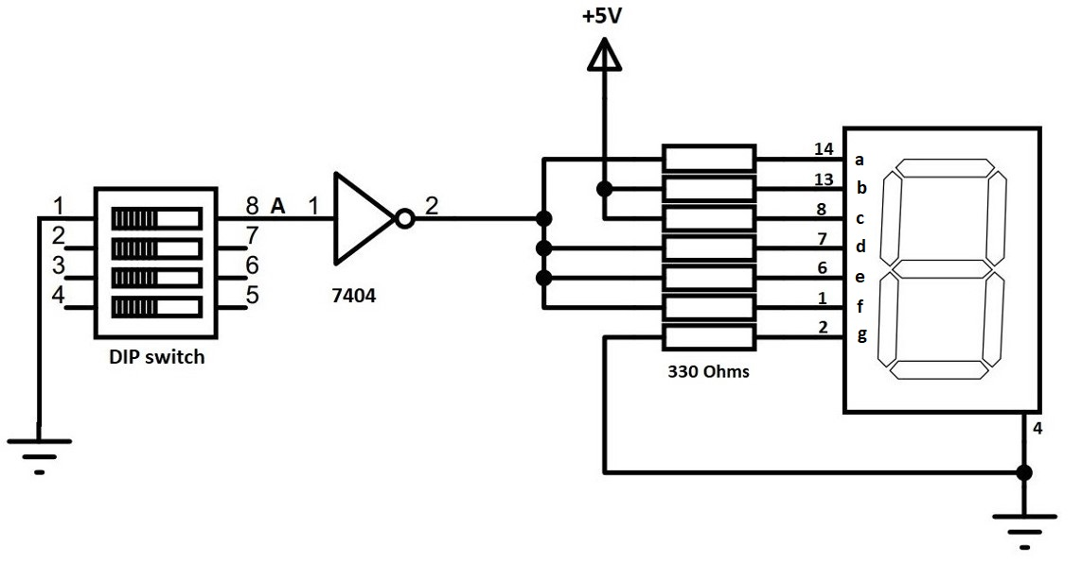
Interfacing 7-segment display
Finally, you can make the circuit from the expressions found-
a= Ã; b= 1; c= 1; d = Ã; e = Ã; f = Ã; g= 0

Slide 16
Good news !!!
We’ve received new kits for everyone.
Everyone can take one box and keep it with you.
You need to perform all labs and assignments by yourself from today’s lab.
No lab partners.
You can share power supply modules.

Slide 17
Good news !!!
Your 2nd assignment is due next Friday, 27th October.
It’ll be in the lab
You’ll be making circuits with 7-segments displays.

Slide 18
Change in office hours!!!
Fridays-
12.30 to 2.00 PM, ITE 242

Slide 19
Questions?
Notes:
19

