Slide 1
University of Maryland Baltimore County Department of Computer Science and Electrical Engineering CMPE 212 Laboratory (Discussion 6)
Hasib Hasan
ha26@umbc.edu
Ankit Baingane
ankitb1@umbc.edu
Edward Hanson
ehanson1@umbc.edu
Notes:
1

Slide 2
Minimization of Boolean Expression
To reduce the number of logic gates needed to perform a particular logic operation.
Reduction of device size.
Reduction of power consumption.
Reduction of heating problem.
Faster devices.
Low cost.

Slide 3
Minimization of Boolean Expression
Techniques:
Boolean algebra
Karnaugh map
Quine–McCluskey algorithm (tabular method)

Slide 4
Minimization of Boolean Expression using K-Map
Karnaugh map (k-map):
Draw your table for the exact no. of input variables.
You’ll need different K-maps for different outputs.

Slide 5
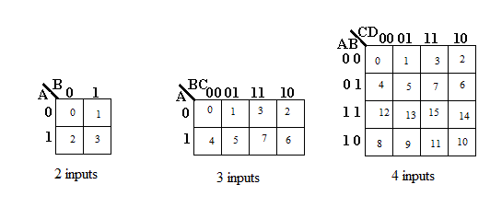
Minimization of Boolean Expression using K-Map
Karnaugh map (k-map):

Slide 6
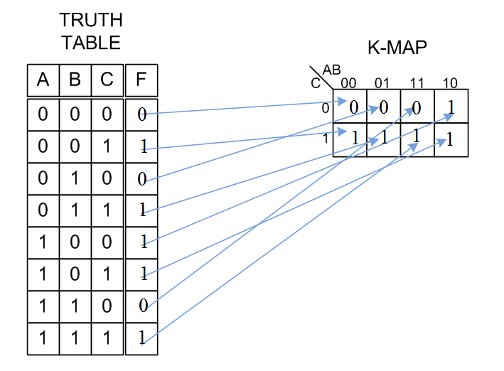
Minimization of Boolean Expression using K-Map
Map your truth table into the K-map:

Slide 7
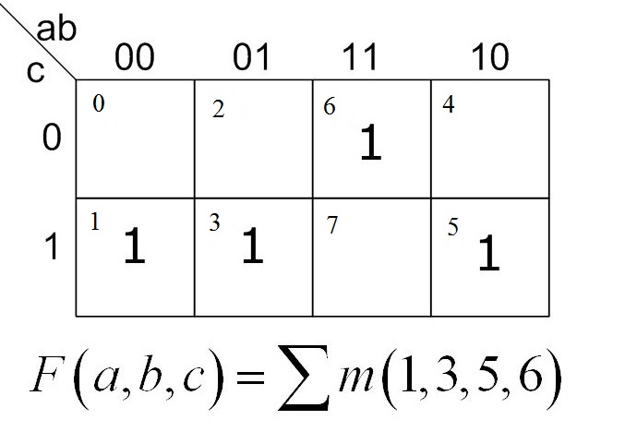
Minimization of Boolean Expression using K-Map
If function is given in SOP forms, map using the cell no.-

Slide 8
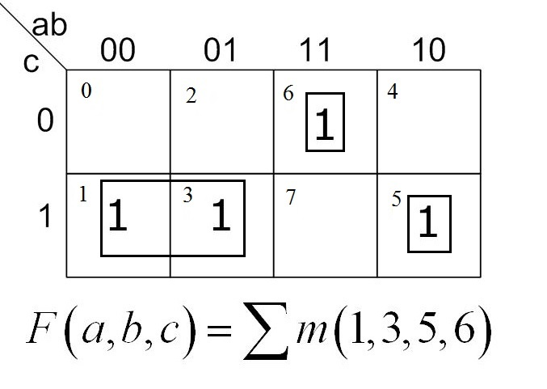
Minimization of Boolean Expression using K-Map
Make groups out of the cells with 1s-

Slide 9
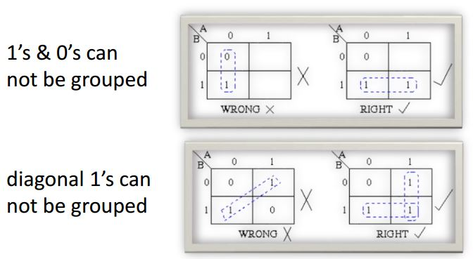
Minimization of Boolean Expression using K-Map
Rules for making groups-

Slide 10
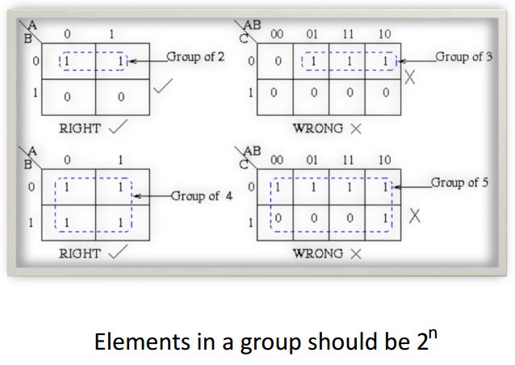
Minimization of Boolean Expression using K-Map
Rules for making groups-

Slide 11
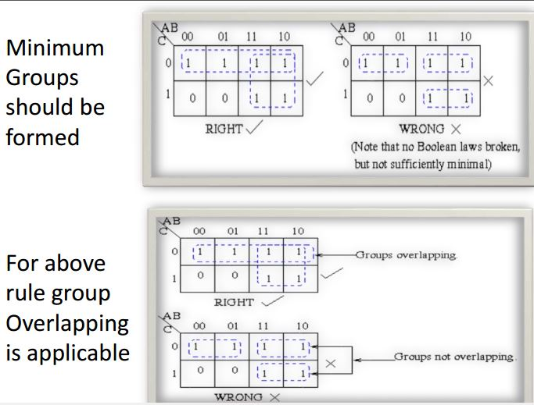
Minimization of Boolean Expression using K-Map
Rules for making groups-

Slide 12
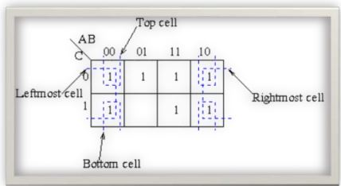
Minimization of Boolean Expression using K-Map
Rules for making groups-
You can make groups with the top and the bottom cells as well as rightmost and the leftmost cells-

Slide 13
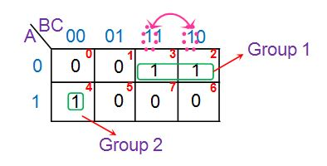
Minimization of Boolean Expression using K-Map
Lastly, find out the function from the groups you made-
Express each group in terms of input variables by looking at the common variables seen in cell-labelling.
All the 'ones' in the Group 1 of the K-map are present in the row for which A = 0. Thus they contain the variable A̅. Further these two 'ones' are present in adjacent columns which have only B term in common as indicated by the pink arrow in the figure. Hence the next term is B. This yields the product term corresponding to this group as A’B. Similarly the 'one' in the Group 2 of the K-map is present in the row for which A = 1. Further the variables corresponding to its column are B̅C̅. Thus one gets the overall product-term for this group as AB̅C̅.
Final expression:
Sum of all individual group’s expressions
Y= A’B + AB’C’

Slide 14
Questions?
Notes:
14

