Slide 1
University of Maryland Baltimore County Department of Computer Science and Electrical Engineering CMPE 212 Laboratory (Discussion 4)
Hasib Hasan
ha26@umbc.edu
Ankit Baingane
ankitb1@umbc.edu
Edward Hanson
ehanson1@umbc.edu
Notes:
1

Slide 2
Boolean Algebra
Boolean Algebra is the mathematics we use to analyse digital gates and circuits.
A set of rules or Laws of Boolean expressions have been invented to help reduce the number of logic gates needed to perform a particular logic operation
Results a list of functions or theorems known commonly as the Laws of Boolean Algebra

Slide 3
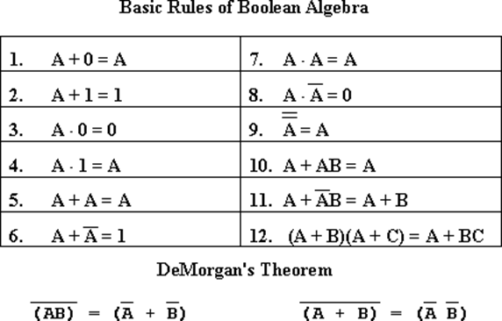
Laws of Boolean Algebra

Slide 4
Converting Truth Table to Boolean Expression
X | Y | Z | Output
0 | 0 | 0 | 0
0 | 0 | 1 | 1
0 | 1 | 0 | 0
0 | 1 | 1 | 0
1 | 0 | 0 | 1
1 | 0 | 1 | 1
1 | 1 | 0 | 1
1 | 1 | 1 | 1
X’.Y’.Z +X.Y’.Z’ + X.Y’.Z + X.Y.Z’ + X.Y.Z

Slide 5
Converting Truth Table to Boolean Expression
Simplification using Boolean algebra-
X’.Y’.Z +X.Y’.Z’ + X.Y’.Z + X.Y.Z’ + X.Y.Z
X’.Y’.Z +X.Y’.Z’ + X.Y’.Z + X.Y.(Z + Z’)
X’.Y’.Z +X.Y’.Z’ + X.Y’.Z + X.Y
X’.Y’.Z +X.Y’.Z + X.Y’.Z’ + X.Y
Y’.Z (X’ + X) + X.Y’.Z’ + X.Y
Y’.Z + X.Y’.Z’ + X.Y
Y’.Z + X (Y’ + Z’) + X.Y
Y’.Z + X .Y’ + X. Z’ + X.Y
Y’.Z + X (Y’ + Z’ + Y)
Y’Z + X (1 + Z’)
Y’Z + X

Slide 6
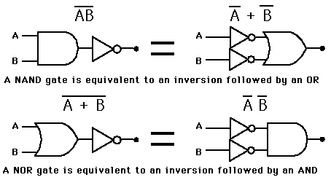
De Morgan’s theorem

Slide 7
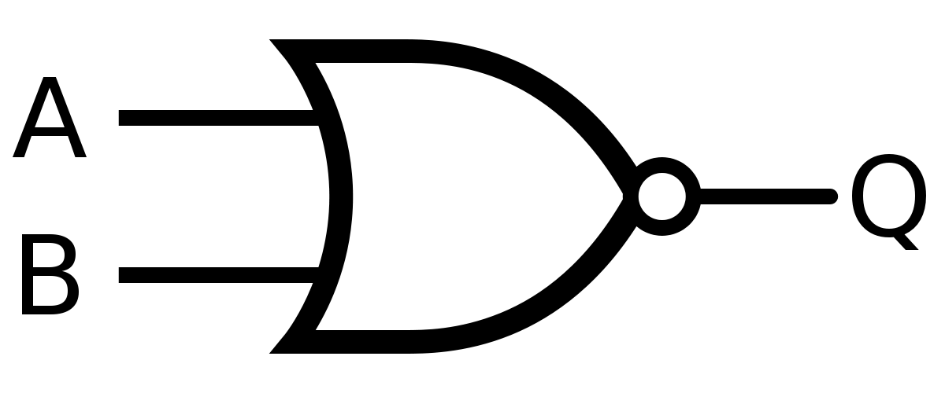
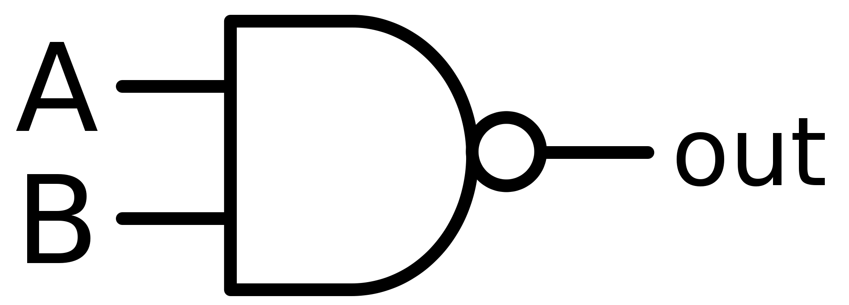
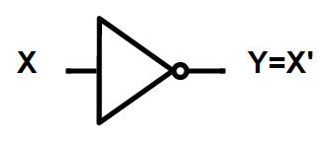
NOT, NAND, and NOR gates
NOR
X | Y
0 | 1
1 | 0
A | B | Q
0 | 0 | 1
0 | 1 | 0
1 | 0 | 0
1 | 1 | 0
A | B | out
0 | 0 | 1
0 | 1 | 1
1 | 0 | 1
1 | 1 | 0
NOT
NOR
NAND

Slide 8
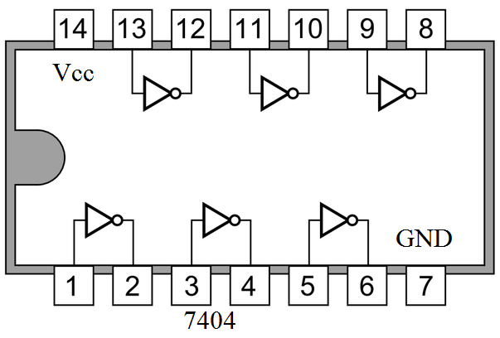
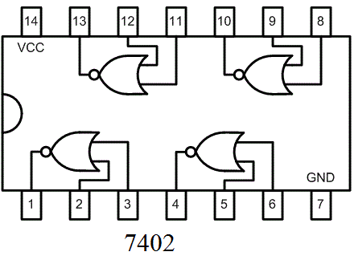
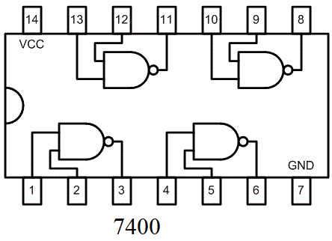
NOT, NAND, and NOR gates
IC 7404
IC 7402
IC 7400
NOT
NOR
NAND

Slide 9
NOT, NAND, and NOR gates in Verilog
Y=~X
or,
not(Y,X)
Q=A~|B
or,
nor(Q,A,B)
out=A~&B
or,
nand(out,A,B)
NOT
NOR
NAND

Slide 10
Announcement:
You can come and practice with your circuits on Tuesdays 3.30-5.00 PM in ITE 242 !!!
Notes:
10

Slide 11
Questions?
Notes:
11

