Slide 1
University of Maryland Baltimore County Department of Computer Science and Electrical Engineering CMPE 212 Laboratory (Discussion 4)
Hasib Hasan
ha26@umbc.edu
Ankit Baingane
ankitb1@umbc.edu
Edward Hanson
ehanson1@umbc.edu
Notes:
1

Slide 2
Debugging of Electronic Circuits
Will be covering-
Few reasons for the circuit not working.
Systematic way to observe the output of an electronic circuit and also debugging.
Common tips for building circuits without making errors.

Slide 3
Debugging of Electronic Circuits
Few reasons for the circuit not working-
Mistakes while building the circuit
Putting wires/devices in the wrong hole of the breadboard-
Eventually shorting the undesired nodes
Loose connections of the wires
Devices put on the breadboard improperly
Problem with the power supply module
ICs or other devices are faulty
You don’t know why !!!

Slide 4
Debugging of Electronic Circuits
Before starting building the circuit-
Have the exact idea what you are going to build
Have the circuit drawn in front of you, including the pin no. of the ICs if you are going to use any.
Always know the functionality of every pins of an IC you’re going to use
Use datasheet/pinout diagram of the ICs
Don’t give the power supply to your circuit before finishing the whole circuit.

Slide 5
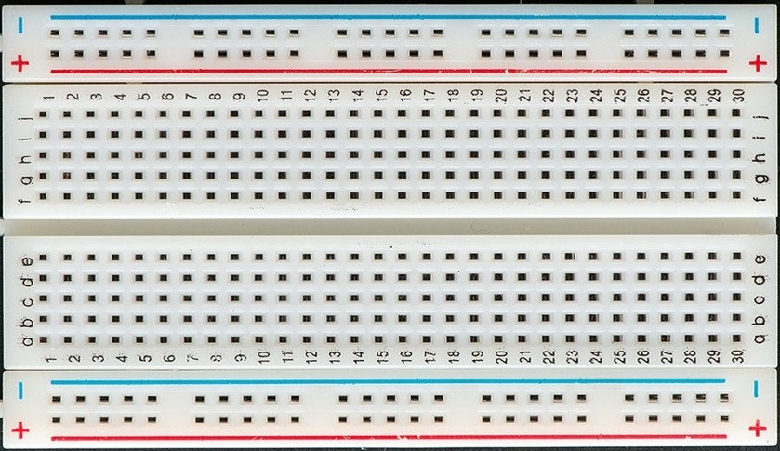
Debugging of Electronic Circuits
Before starting building the circuit-
Have clear idea on the connectivity within the breadboard-

Slide 6
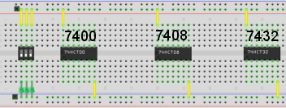
Debugging of Electronic Circuits
Few tips on making the circuit-
Always start with putting in the ICs. Put them in the middle of the two arrays of holes.

Slide 7
Debugging of Electronic Circuits
Few tips on making the circuit-
Mark your power and ground bus. It’s better to use the markings on the breadboard.
Use lines on the opposite sides

Slide 8
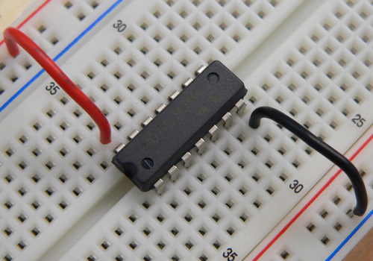
Debugging of Electronic Circuits
Few tips on making the circuit-
Connect the power and ground to your ICs’ corresponding pins

Slide 9
Debugging of Electronic Circuits
Few tips on making the circuit-
Keep the connecting wires short
Makes it easier to see the connections and hence debug.
Lets your multimeter probes more accessible to the connections.
Improves overall functioning of the circuit by offering less voltage drops.
Looks lees messy.

Slide 10
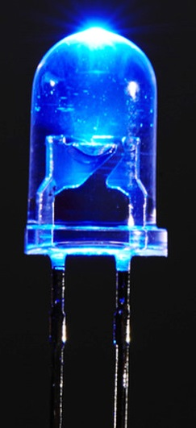
Debugging of Electronic Circuits
Few tips on making the circuit-
Try to use resistors of 330 Ohms to your output LEDs.
Gives brighter light and hence easier to detect.
Check the polarity of the LEDs. Sometimes, the longer legs aren’t always the anode !!! Also, you can’t always find the longer leg out.
You can identify the Anode leg looking inside. Smaller part indicates the Anode.
Most reliable way is using the multimeter.

Slide 11
Debugging of Electronic Circuits
Observing the functionality of the circuit:
Check the whole circuit for any errors with the connections before giving the power supply.
Always make your inputs all zeros before connecting to the power.
Give the power connection
Don’t forget to switch ON the OUTPUT of the power module

Slide 12
Debugging of Electronic Circuits
Observing the functionality of the circuit:
Change your input gradually from 0000 to 1111.
Observe the output for each input combinations and note down.
If all the outputs are as they should be (you should be having your truth table beforehand), you’re all done, congratzz !!!!
If not, then follow..

Slide 13
Debugging of Electronic Circuits
Debugging:
Most of the cases, you don’t have the desired output at the beginning.
Grab your multimeter and start debugging.
We’ll be mainly measuring the voltages at different nodes.
Keep your multimeter dial at DC voltage and preferably, at 20V DC.

Slide 14
Debugging of Electronic Circuits
Debugging:
Check the voltages at the power and ground pin of the ICs-
Power pin should read close to 5V and ground 0V.
Give any specific input using the input DIP switches.
Start measuring from the input following the signal flow through to output and find the fault out !

Slide 15
Debugging of Electronic Circuits
Debugging:
Note: All the circuits you’ll be building in this course are digital circuits. So, remember-
Voltages close to 5V (>3V) is logic 1
Voltages close to 0V (<0.2V) is logic 0

Slide 16
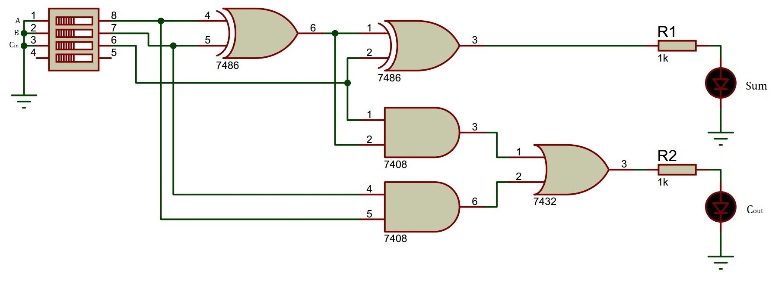
Debugging of Electronic Circuits
Debugging:
Example circuit:

Slide 17
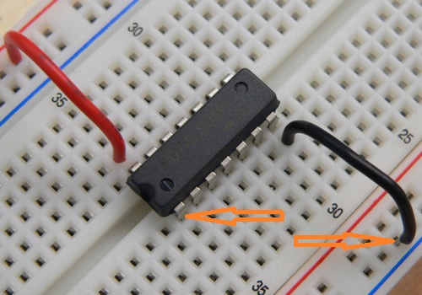
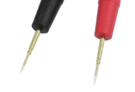
Debugging of Electronic Circuits
Debugging: While measuring, always connect your black lead to the ground and red lead to the measuring nodes.
Touch the lead at te bottom of the pins/wires.

Slide 18
Debugging of Electronic Circuits
Most importantly,
Don’t panic.
Keep debugging systematically.
Start over if you are stuck or panicked.

Slide 19
Have Fun Making Your Circuit !!!
Questions?
Notes:
<number>

Slide 20
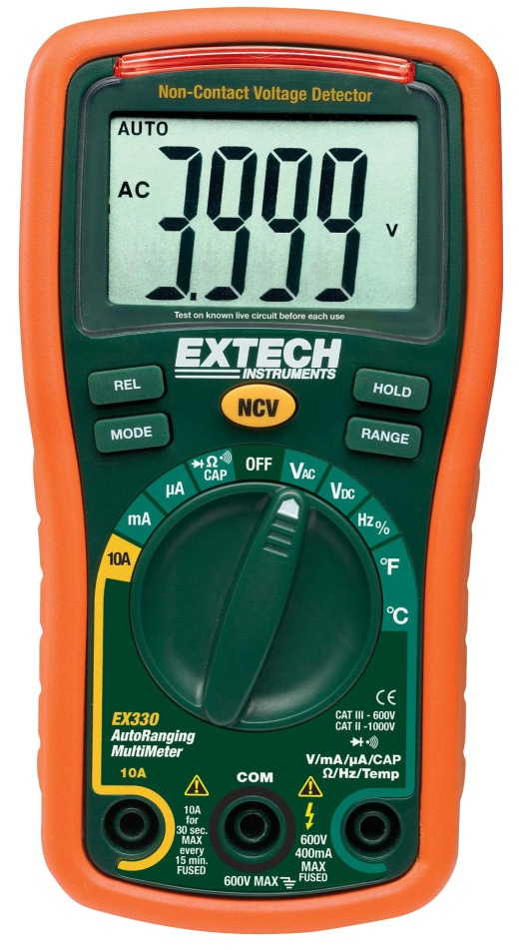
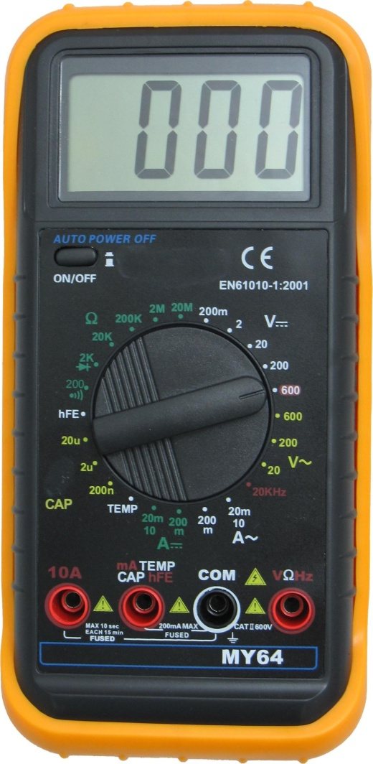
Multimeter

Slide 21
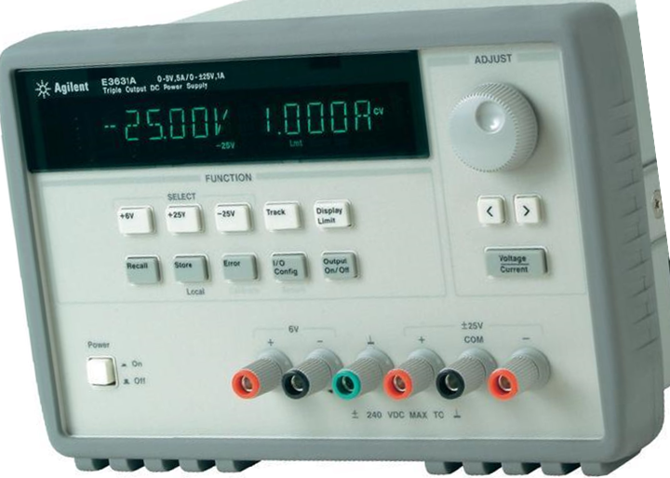
Power Supply
Meter selection keys
Adjust knob
Output On/Off key
Resolution select keys
Adjust Voltage or Current?
Power Supply Outputs

