Slide 1
University of Maryland Baltimore County Department of Computer Science and Electrical Engineering CMPE 212 Laboratory (Discussion 3)
Hasibul Hasan
ha26@umbc.edu
Ankit Baingane
ankitb1@umbc.edu
Edward Hanson
ehanson1@umbc.edu

Slide 2
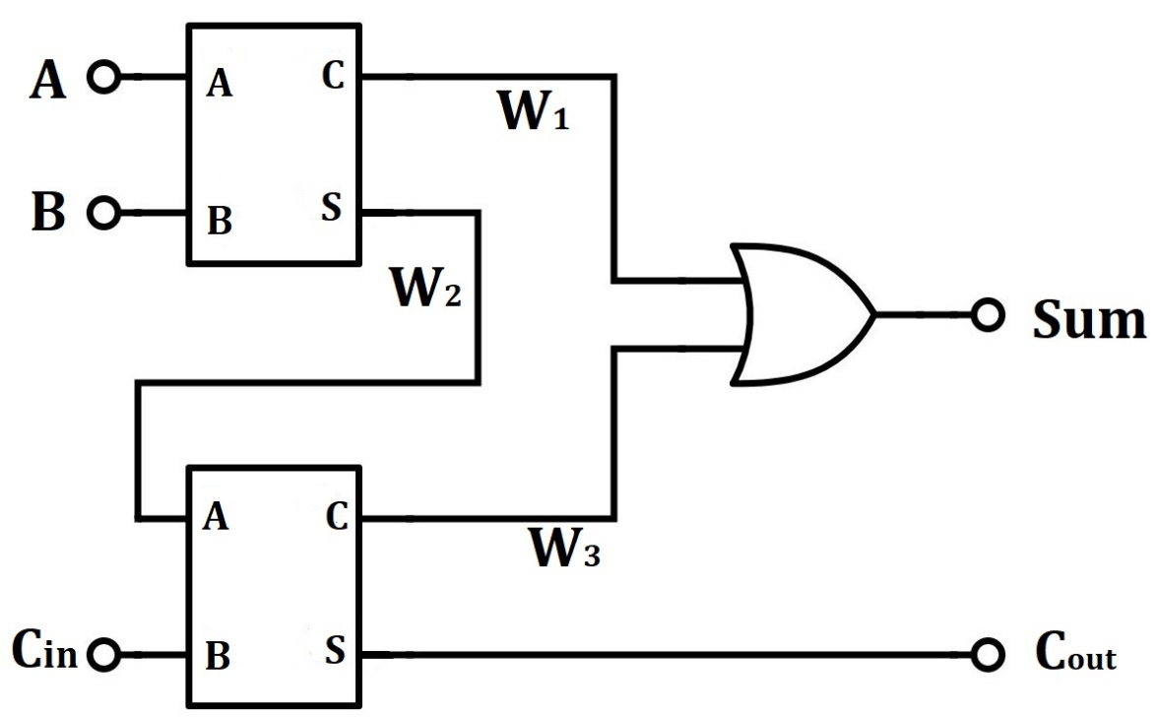
Making Full Adder using Two Half Adders in Verilog

Slide 3
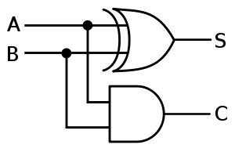
Making Full Adder using Two Half Adders in Verilog
Half adder module:
module ha(Sum,Carry,A,B);
input A,B;
output Sum,Carry;
assign Sum=A^B;
assign Carry=A&B;
endmodule

Slide 4
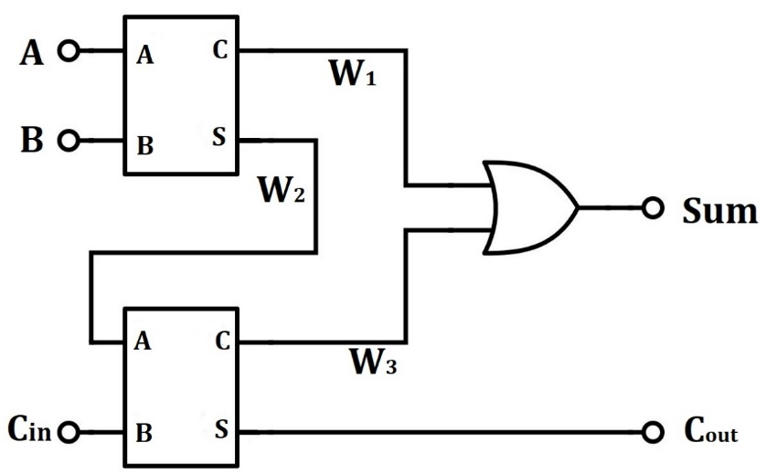
Making Full Adder using Two Half Adders in Verilog
Full adder module:
`include "Half_Adder.v"
module fa(Sum,Cout,A,B,Cin);
input A,B,Cin;
wire W1,W2,W3;
output Sum,Cout;
ha f1(W2,W1,A,B);
ha f2(Sum,W3,W2,Cin);
assign Cout=W1|W3;
endmodule

Slide 5
Making Full Adder using Two Half Adders in Verilog
Full adder Testbench:
module fa_tb();
reg[2:0] in;
wire Sum,Cout;
fa function1(Sum,Carry,in[2],in[1],in[0]);
initial
begin
in = 3'b000;
repeat(7) #50 in=in+1'b1;
end
initial
$monitor(" A=%b B=%b Cin=%b ---> Sum=%b Cout=%b",in[2],in[1],in[0],Sum,Carry);
endmodule

Slide 6
Making Full Adder using Two Half Adders in Verilog
Output:
A=0 B=0 Cin=0 ---> Sum=0 Cout=0
A=0 B=0 Cin=1 ---> Sum=1 Cout=0
A=0 B=1 Cin=0 ---> Sum=1 Cout=0
A=0 B=1 Cin=1 ---> Sum=0 Cout=1
A=1 B=0 Cin=0 ---> Sum=1 Cout=0
A=1 B=0 Cin=1 ---> Sum=0 Cout=1
A=1 B=1 Cin=0 ---> Sum=0 Cout=1
A=1 B=1 Cin=1 ---> Sum=1 Cout=1

Slide 7
Hardware Implementation of a Full Adder Circuit

Slide 8
Hardware Implementation of a Full Adder Circuit
IC part no. of the logic gates:
IC no. | Description
7400 | quad 2-input NAND gate
7402 | quad 2-input NOR gate
7404 | hex INVERTER
7408 | quad 2-input AND gate
7432 | quad 2-input OR gate
7486 | quad 2-input XOR gate

Slide 9
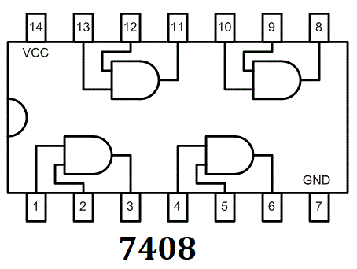
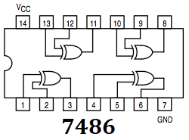
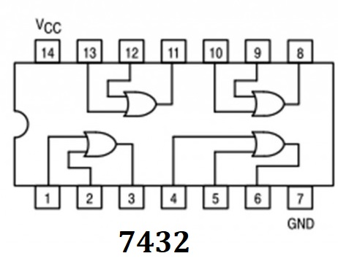
Hardware Implementation of a Full Adder Circuit
Pinouts of IC 7408,7432, and 7486:

Slide 10
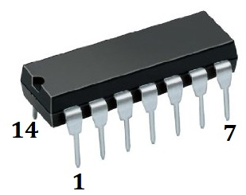
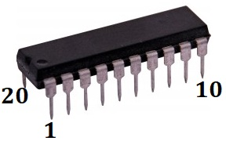
Hardware Implementation of a Full Adder Circuit
Counting pin no. of DIP Ics:
For any IC, find its datasheet online.
e.g. http://alldatasheet.com/

Slide 11
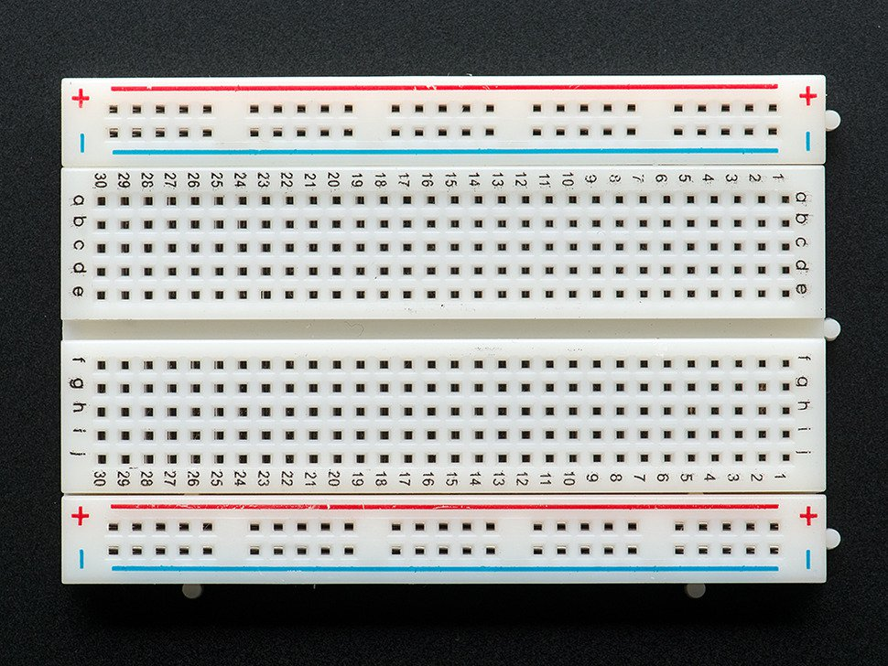
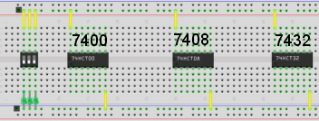
Hardware Implementation of a Full Adder Circuit
Placing ICs in a breadboard:

Slide 12
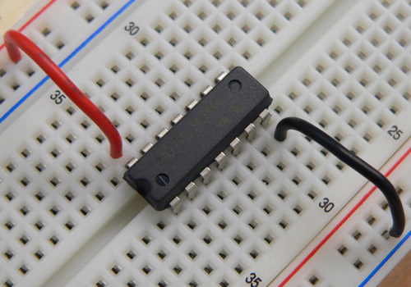
Hardware Implementation of a Full Adder Circuit
Placing ICs in a breadboard:

Slide 13
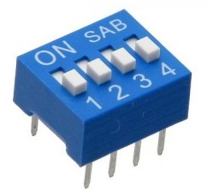
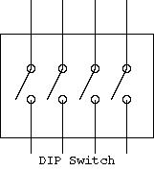
Hardware Implementation of a Full Adder Circuit
DIP switch:
Used for giving inputs to the logic circuits.
Connect one end to the ground and the other to the input pin of your ICs.
Important: Switching ON the DIP switch will simply close the switch.
If connected to power, switch on is giving input ‘1’
If connected to ground, switch on is giving input ‘0’

Slide 14
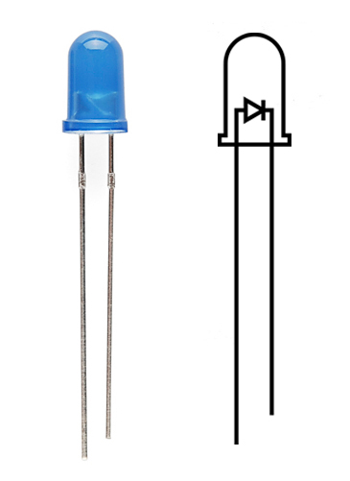
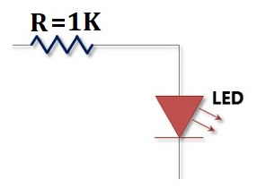
Hardware Implementation of a Full Adder Circuit
LEDs:
Used for observing the output of the logic circuits.
Always use with a resistor in series
Use multimeter in case you can’t find the longer leg out.

Slide 15
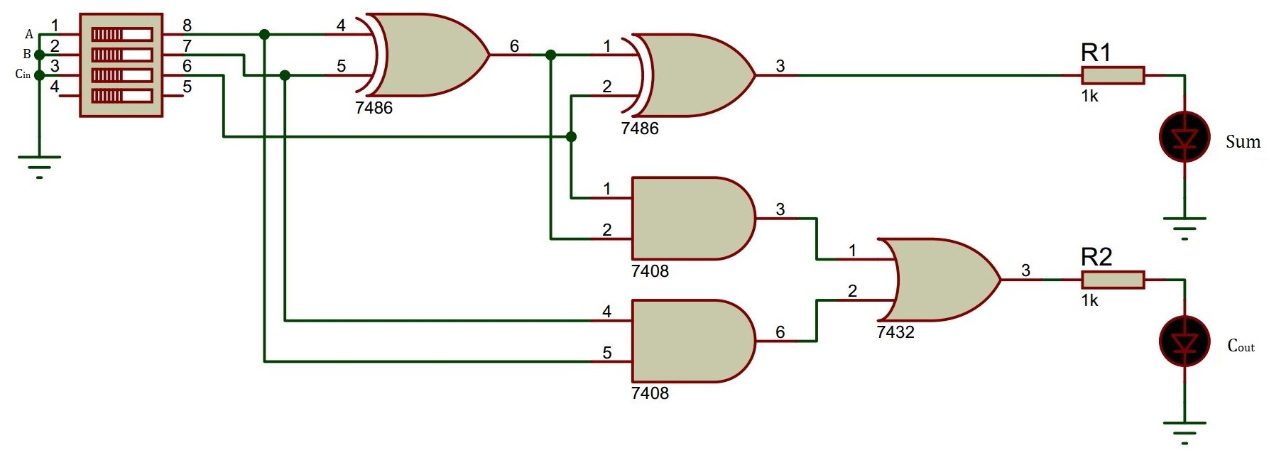
Hardware Implementation of a Full Adder Circuit
Schematic-

Slide 16
Bad News !!!
Your first Lab assignment is due next Friday, 29th Sep
You’ll be given a combinational logic circuit-
You need to verify its truth table using Verilog.
Implement it with hardware.

Slide 17
Questions?

Slide 18
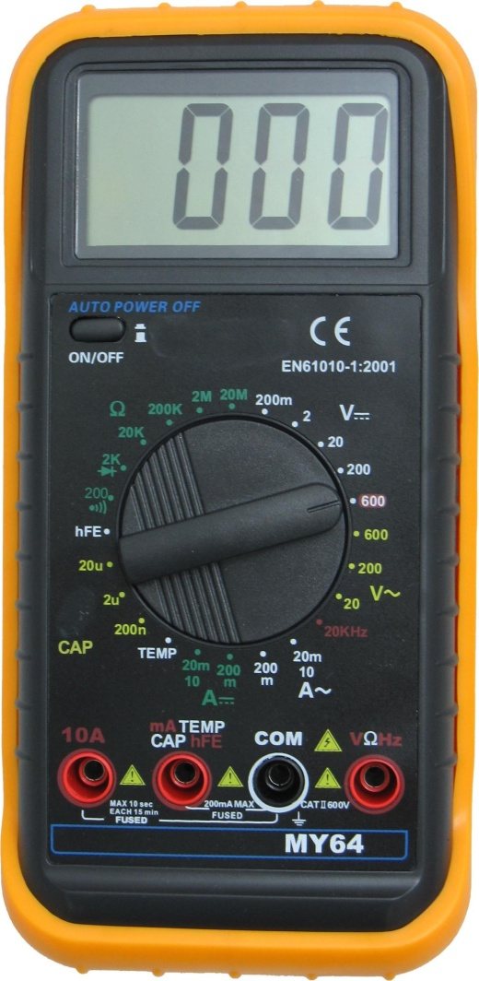
Multimeter

Slide 19
Power Supply
Meter selection keys
Adjust knob
Output On/Off key
Resolution select keys
Adjust Voltage or Current?
Power Supply Outputs

