Slide 1
CMPE212: LABORATORY
Discussion Hours: Fri 1:00 – 1:50PM in ITE 227
Fri 2:00 – 2:50PM in ITE 242 (optional)
* Most of the slides are courtesy of previous TA: Rashidul Islam and Patrick Sykes

Slide 2
Your TAs
Hasibul Hasan
Email: ha@umbc.edu
Office Hour: Fri 11:00 AM to 12:30 PM (ITE334)

Slide 3
Lab Grade
Attendance 10%
Did you show up?
Completion 30%
Did you complete the lab?
Clean bench 10%
Did you clean up afterwards?
Lab Assignment 50%
Lab assignment will be provided once in a month. You will be asked to solve it in your Lab hour.
Total No. of Lab assignment: 4
Good News: No need to submit any Lab report

Slide 4
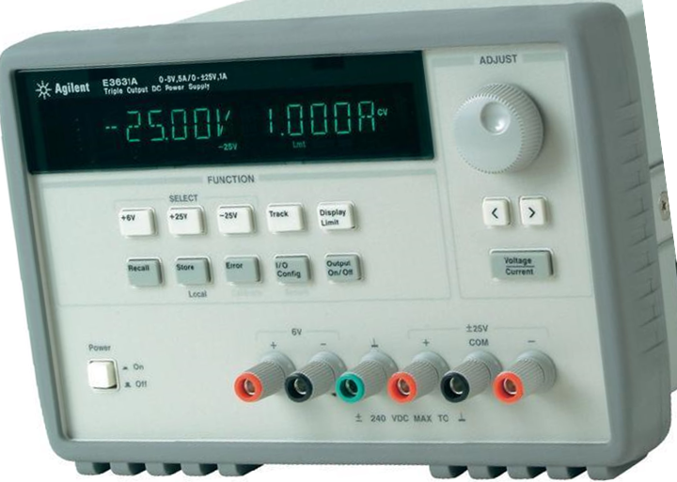
Equipment: Power Supply Modules
Meter selection keys
Adjust knob
Output On/Off key
Resolution select keys
Adjust Voltage or Current?
Power Supply Outputs

Slide 5
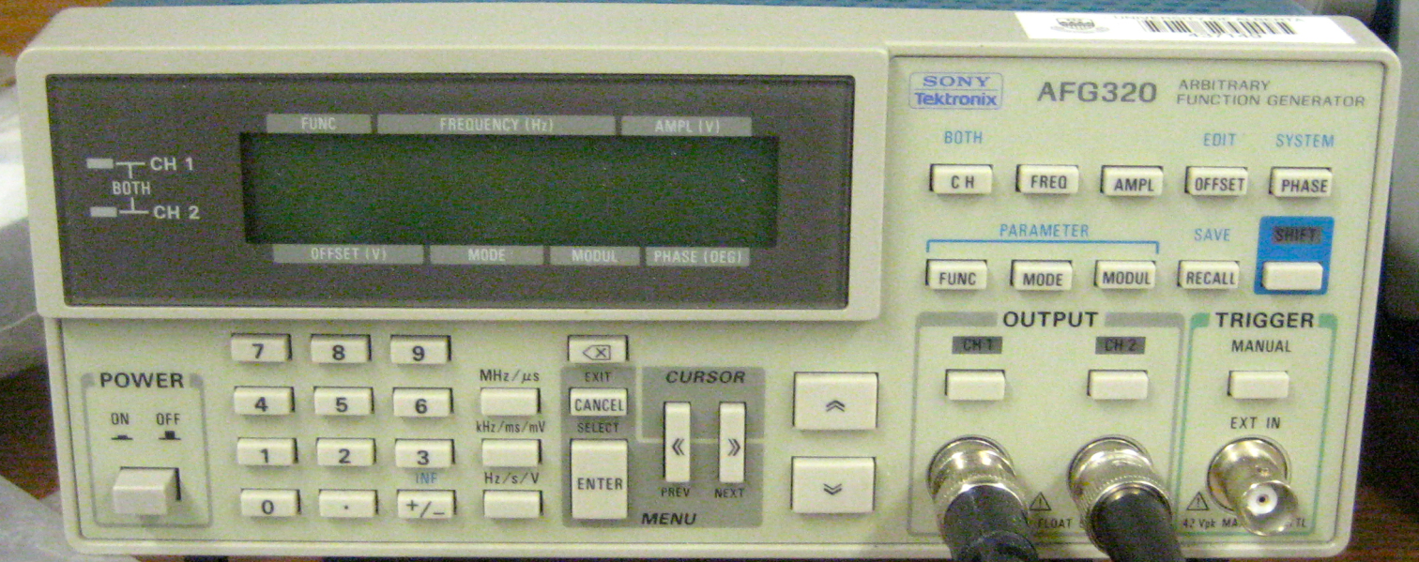
Equipment: Function Generator
Select Function
Select Frequency
Select Amplitude
Write value
Choose digit
Inc/dec digit
Output on

Slide 6
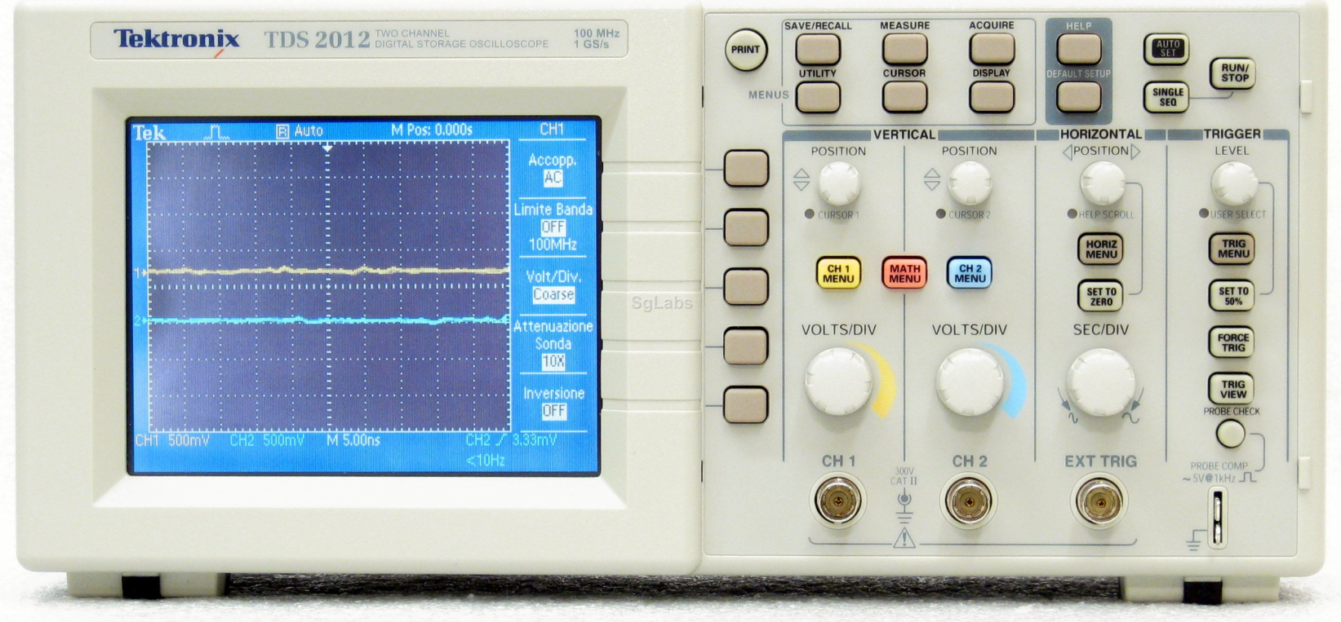
Equipment: O-scope
Measure
Auto Set
Option buttons
Vertical position
Vertical
scale factor
Horizontal
scale factor
Horizontal
position
Autoset function will be your “best friend”. It obtains a stable waveform display for you. It also automatically adjusts the vertical and horizontal scale.
Notes:
Some O-scopes have a “menu off” button, but most in our lab do not.

Slide 7
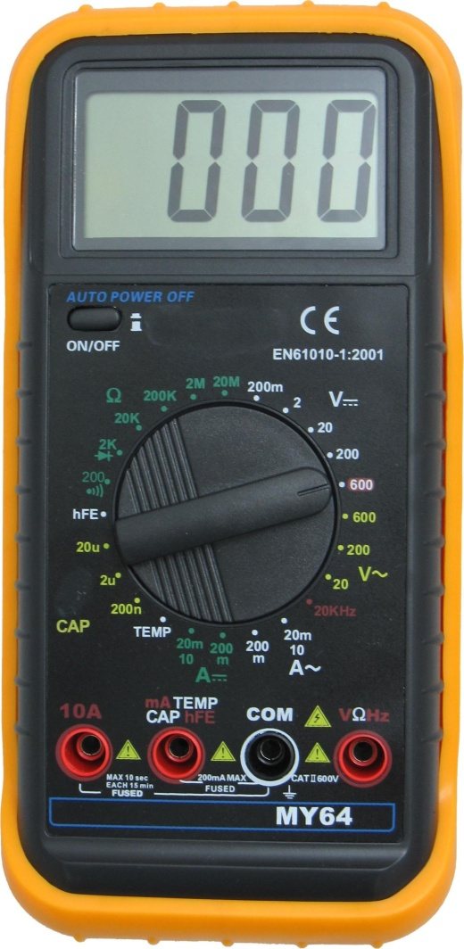
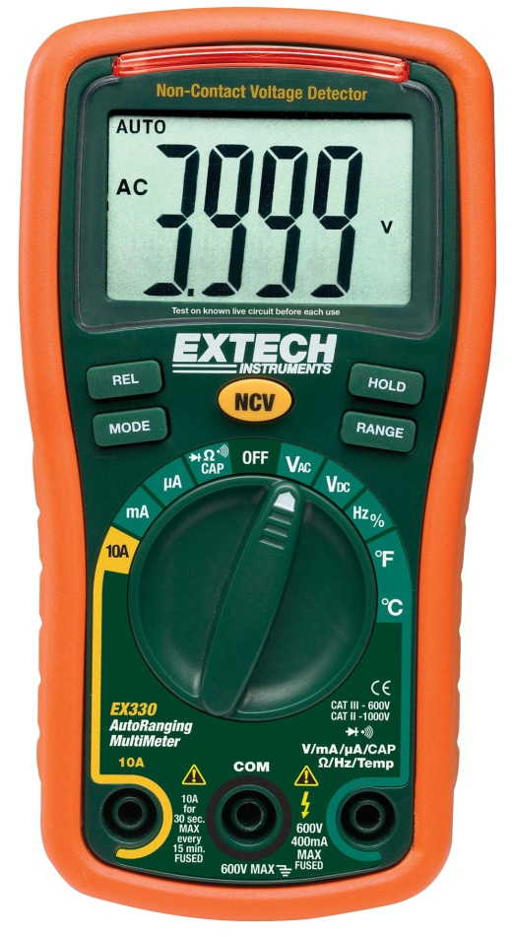
Equipment: Multimeter (DMM)
Dial
Decides whether you’re reading voltage, current, or resistance.
Also sets your max. limit.
Ports
COM (black) is common ground
Red ports for measuring volt./cur./res.

Slide 8
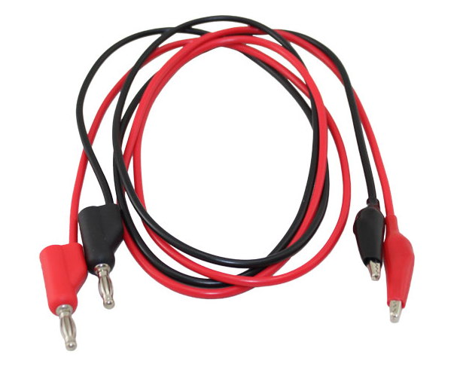
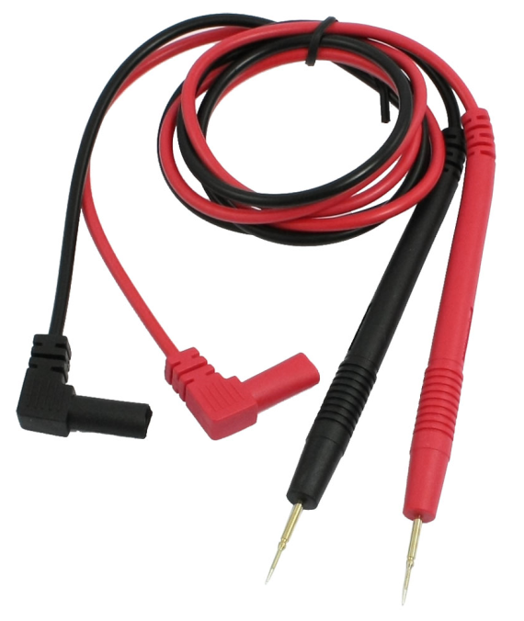
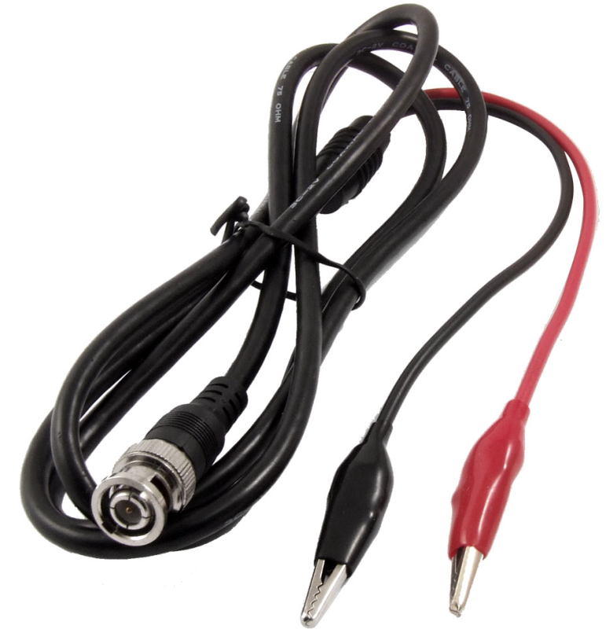
Equipment: Cables
Banana jack – Alligator clips
Multimeter leads
BNC – Alligator clips
to Circuit
to DMM
to DC Power Supply
to Circuit
to Function
Generator
OR O-scope
to Circuit

Slide 9
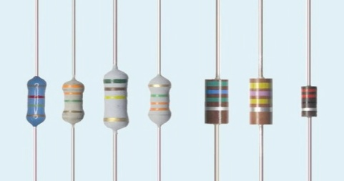
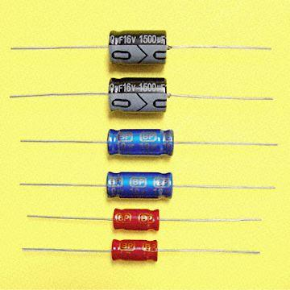
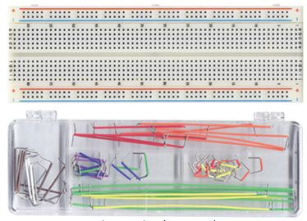
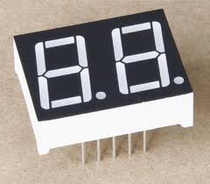
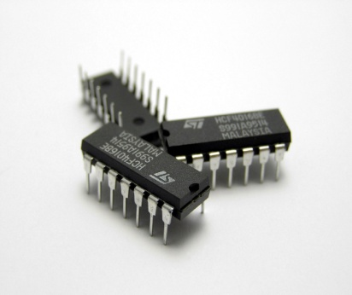
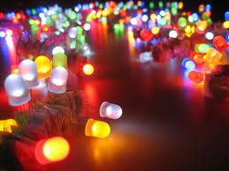
Equipment: Electronic Elements
Resistors
Breadboards
Breadboard wires
LEDs
7-segment displays
Chips (ICs)

Slide 10
Lab1: Be Familiar with Equipment & Make a Simple Circuit
Make the following circuit. Maximum Vcc=5V
Pow. Sup.
Banana jack – Alligator clips
Notes:
The resistor is VERY important!!!! :O
Long leg of the LED is +
Short leg of the LED is –
I will pass out the 330 ohm resistors, LEDS, and breadboards. At the end of class, return the resistors and LEDs, but leave the breadboards at your stations.

Slide 11
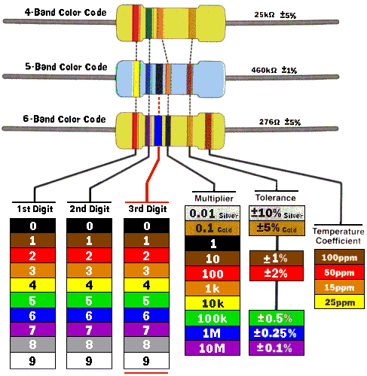
Resistors
1st band - 1st digit of the resistor value
2nd band - 2nd digit of the resistor value
Multiplier - decimal multiplier (×10⁰, ×10¹, ...)
Tolerance - tolerance of the resistor value as a percentage
Notes:
Orange Orange Brown= 330 ohm
Brown Black Red = 1K ohm ...OR Black Brown Orange
Brown Black Orange = 10K ohm

Slide 12
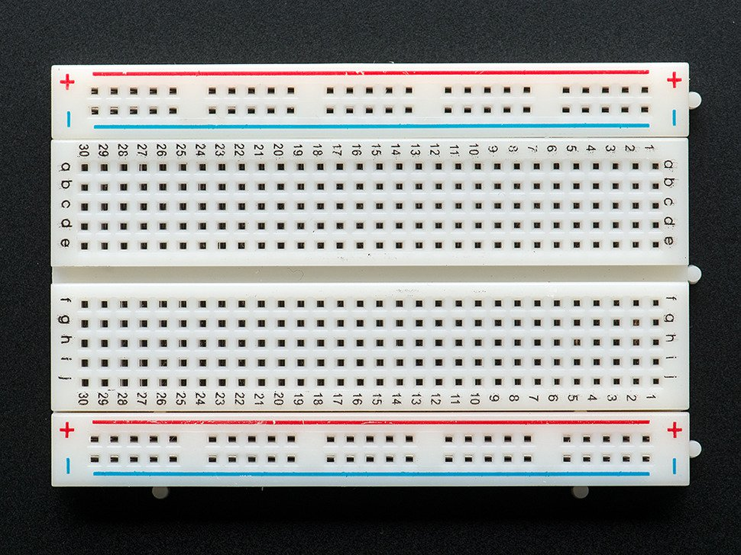
BreadBoard

Slide 13
An Introduction to Verilog
Hardware Description Language (HDL)
Basic idea is a programming language to describe hardware
Initial purpose was to allow abstract design and simulation
Design could be verified then implemented in hardware
Now Synthesis tools allow direct implementation from HDL code.
Large improvement in designer productivity

Slide 14
Verilog
A hardware description language (HDL) to describe:
Wires
Registers
Connection to Registers
Clock Pulses
Verilog is NOT an object oriented language
Verilog uses “modules” instead of functions and methods

Slide 15
Verilog
Syntax is similar to C.
Modular implementation of circuit components:
Modules form the building blocks of circuit components.
Bigger modules are made up of smaller modules.
2 different ways to program (“Levels of Abstraction”):
Behavioral
Structural …more on these later

Slide 16
HDL
HDL: Programming language used to describe the behavior of an electronic circuit.
Uses simulations to test and verify a circuit’s functionality.
Difference between HDL’s and other programming languages: HDL’s include a notion of time.

Slide 17
Tasks
Make group with two team members
Send below info to ha@umbc.edu
Name and email address of each member
One email from each group

