Slide 1
Not only open data, but accessible data and programming tools for beginners
Eni Mustafaraj
OGK 2011
November 5, 2011

Slide 2
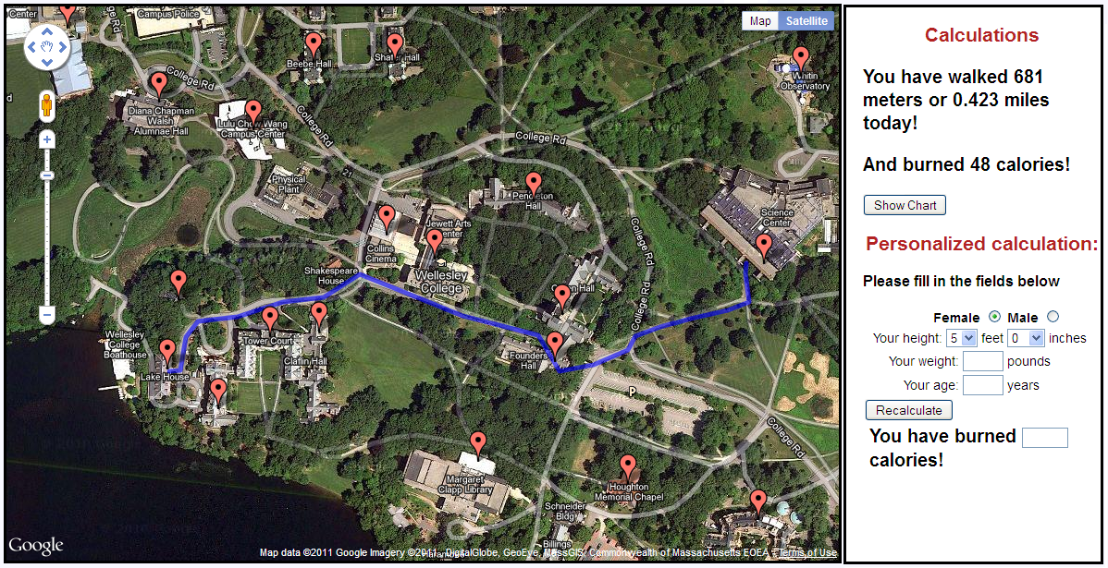
Campus Calorie Cruncher

Slide 3
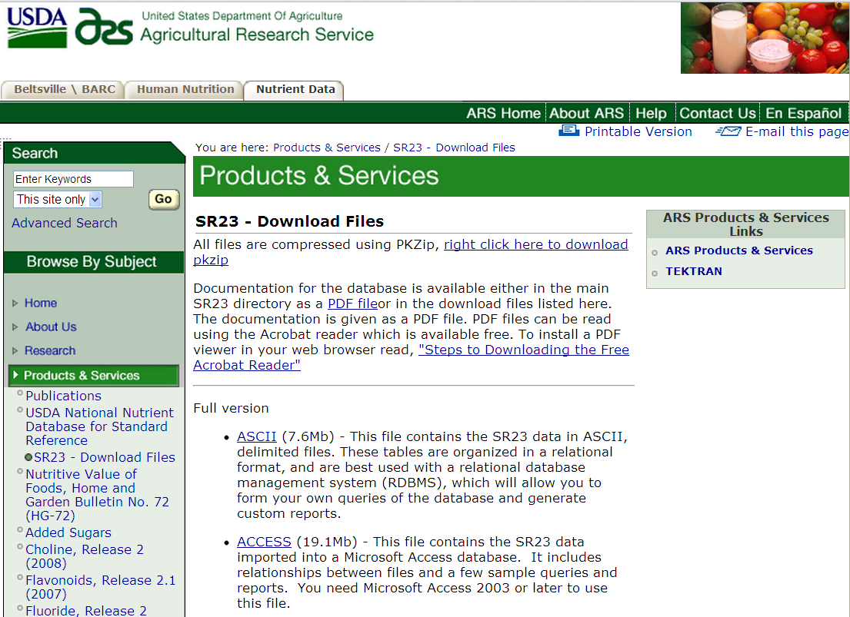
USDA Nutrient Database

Slide 4
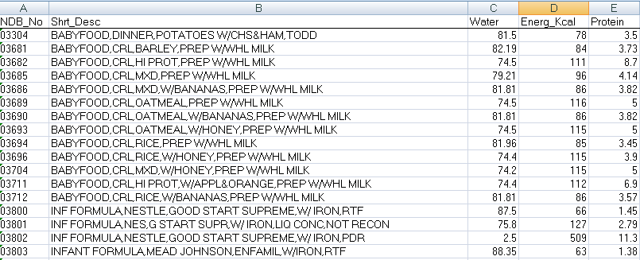
Data from USDA
File size: 10.6 MB, 7638 rows, 53 columns

Slide 5
Finding Data
Is this database the best data for their need?
No.
MyPyramid Food Raw Data (data.gov)
USDA website has no link to it.
Doesn’t show up in Google Results.

Slide 6
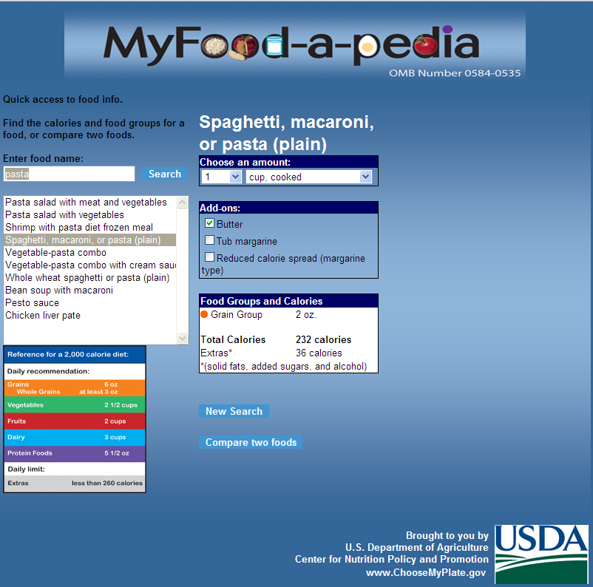
Open-Sourcing Knowledge

Slide 7
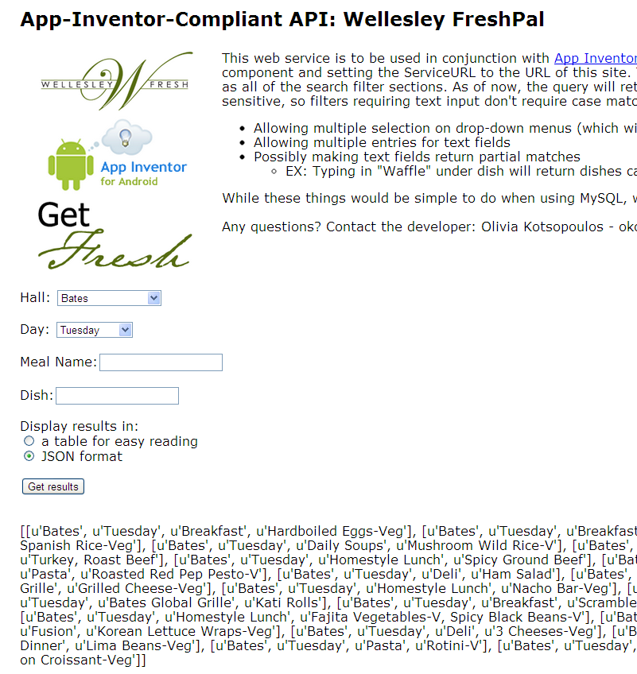
User-friendly APIs

Slide 8
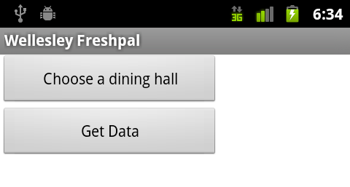
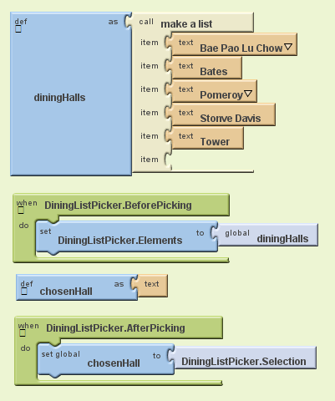
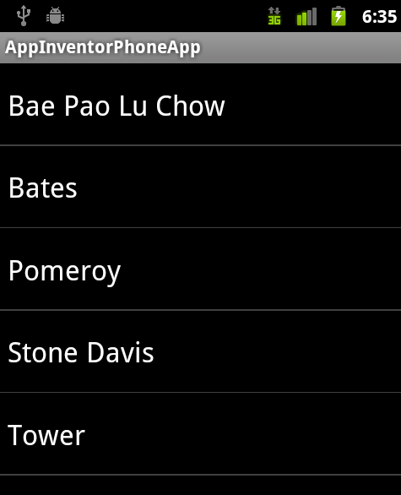
App Inventor for Android

Slide 9
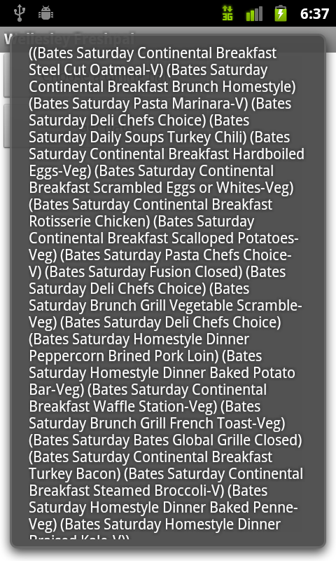
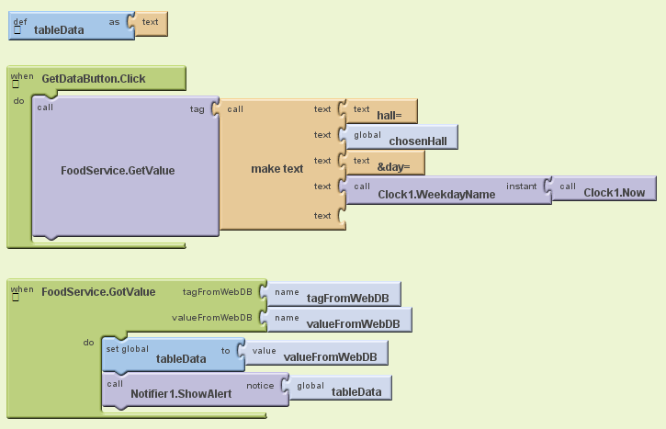
App Inventor for Android

Slide 10
Needs of novice programmers
How to find the best data set?
Access data through simple web services.
Provide AI functionalities as part of service:
Approximate search
Similarity functions
Ranking

Slide 11
Thank you
#questions

