Slide 1
Towards an Effective Ecosystem for Open Public Data
Sree Balakrishnan, Alon Halevy
(sreevb|halevy)@google.com
AAAI Fall Symposium, November 5th, 2011

Slide 2
Challenges Today
Vast amounts of Government/NGO data already public
Growing trend with more joining the bandwagon (OGP)
HOWEVER the data is often:
Siloed and in hard to use formats
Hard to discover through search
Difficult to combine with other data
Requiring multiple complex steps to get into a visualization
As a result:
Insightful analysis lags far behind the growth in the amount of data
The data eco-system is limited to point efforts with no network effect

Slide 3
Building an Eco-system
At Google we believe open structured data is at similar stage to the early web. By providing a set of basic services we can help build a much more effective data eco-system.
These services include:
Provide a cloud based location for data to be shared in a standardized format
Make the data discoverable in search
Make it easy to join data sets
Provide an easy to use tool kit of visualizations
Provide open APIs for import, access, maintenance and export of data
Support easy embedding of visualizations, data
We already have services that provide some of the above
Public Data Explorer (www.google.com/publicdata)
Google Fusion Tables (www.google.com/fusiontables)

Slide 4
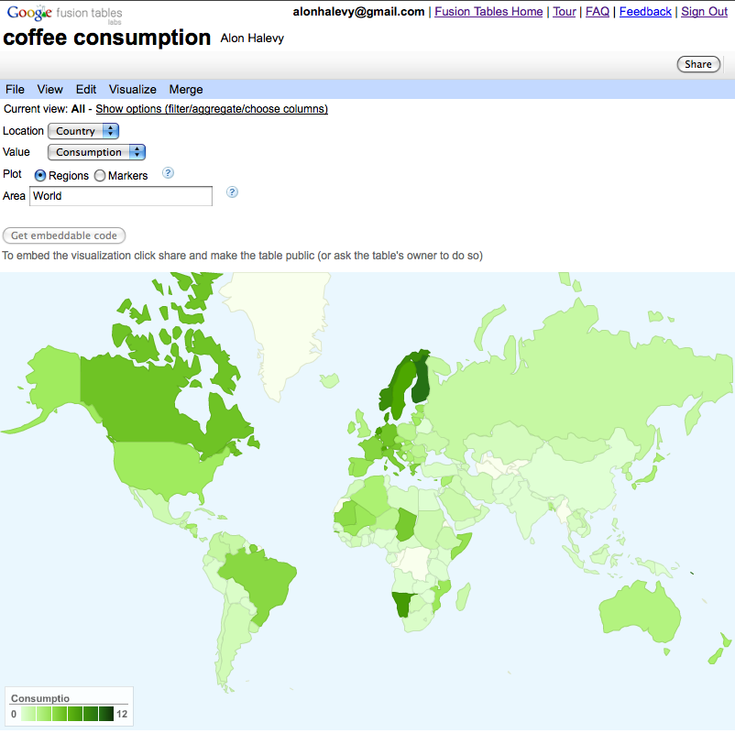
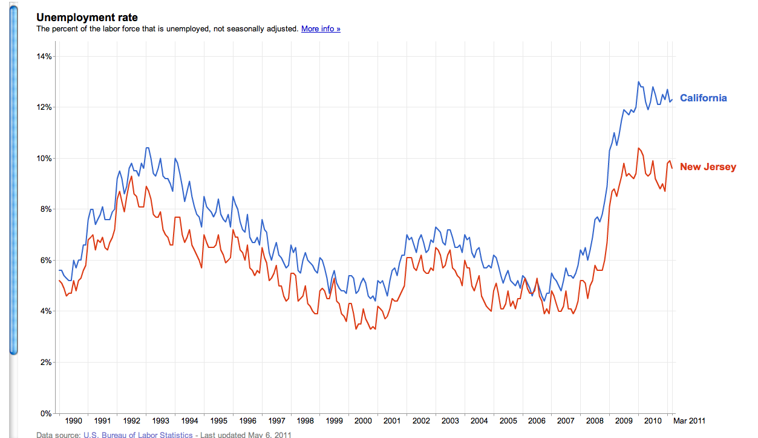
Goal: Structured Data Ecosystem
Discover
Import
Clean
Integrate
Visualize
Query
Share
Publish Communicate

Slide 5
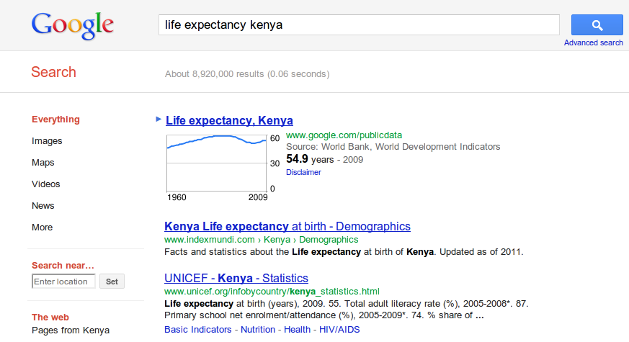
Making public data discoverable
Example: life expectancy kenya

Slide 6
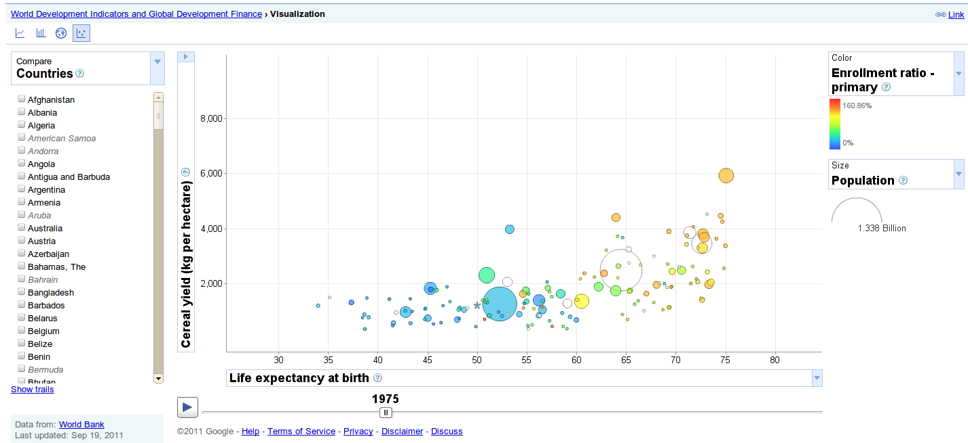
Public Data Explorer
Yield, life expectancy, population, enrollment ratio
link

Slide 7
Fusion Tables google.com/fusiontables
Goal: an easy-to-use database system that is integrated with the Web.
Key features:
Easy upload (CSV, KML, spreadsheets)
Sharing (even outside your company)
Visualizations front and center
Easy publishing
Goal 2: a data cloud -- discover others’ data and combine with yours.

Slide 8
How to Use Fusion Tables
Upload Your Data
Update Table Metadata
Share Your Data
Merge with Other Tables
Make a Map in Minutes!

Slide 9
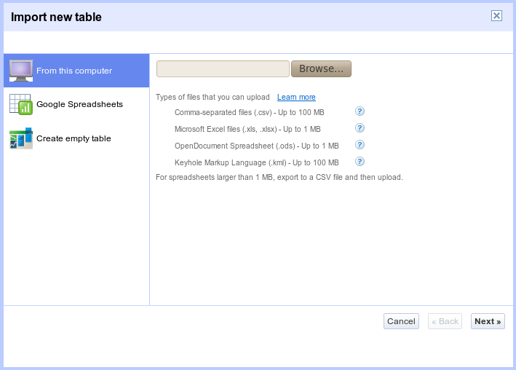
Upload Your Data
Import Your Data - 3 ways
Via the website
KML, CSV, XLS, ODS
Shape file? No problem!
http://shpescape.com
Like to code? Use the API
REST API
SQL-like queries

Slide 10
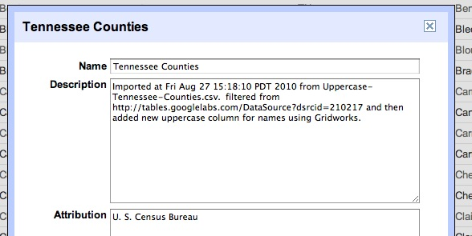
Update Table Metadata
Metadata and attribution
Table Name
Description
Attribution

Slide 11
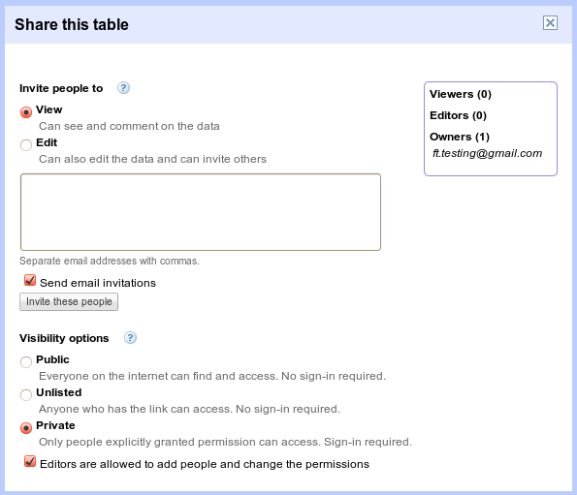
Share Your Data
Permissions & Sharing
Invite individuals to read/write
Share the entire table

Slide 12
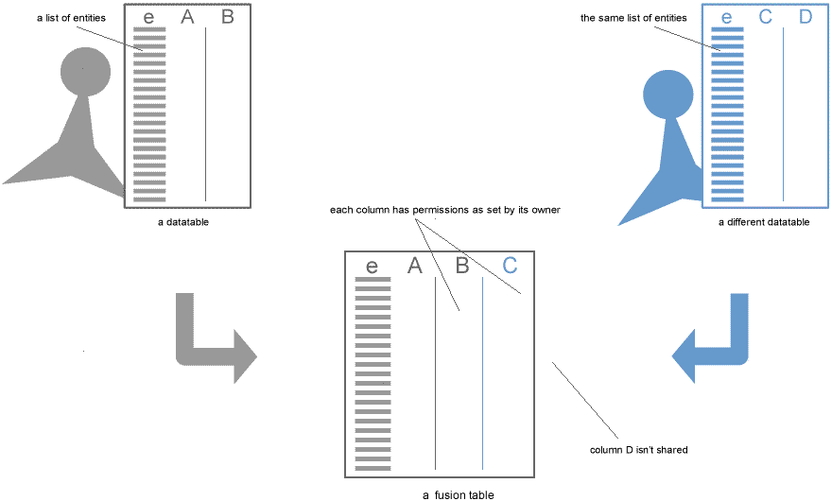
Merge with Other Tables
Combine tables on a shared column

Slide 13
Merge with Other Tables
Find public data tables to merge with

Slide 14
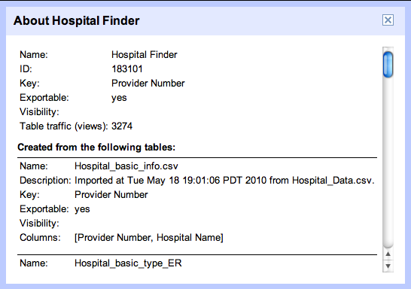
Merge with Other Tables
Provenance tracking

Slide 15
Make a Map* in Minutes! * or chart, or timeline, all interactive
Make a map
Upload data and view as map
Apply styles
Customize Info Window
Get embeddable link or...
Available via Maps API (FusionTablesLayer)

Slide 16
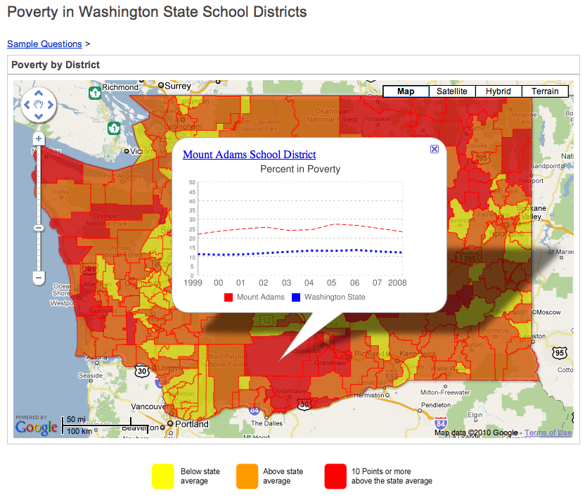
Make a Map* in Minutes! * or chart, or timeline, all interactive
http://www.wikieddata.com/questions/WA_Poverty

Slide 17
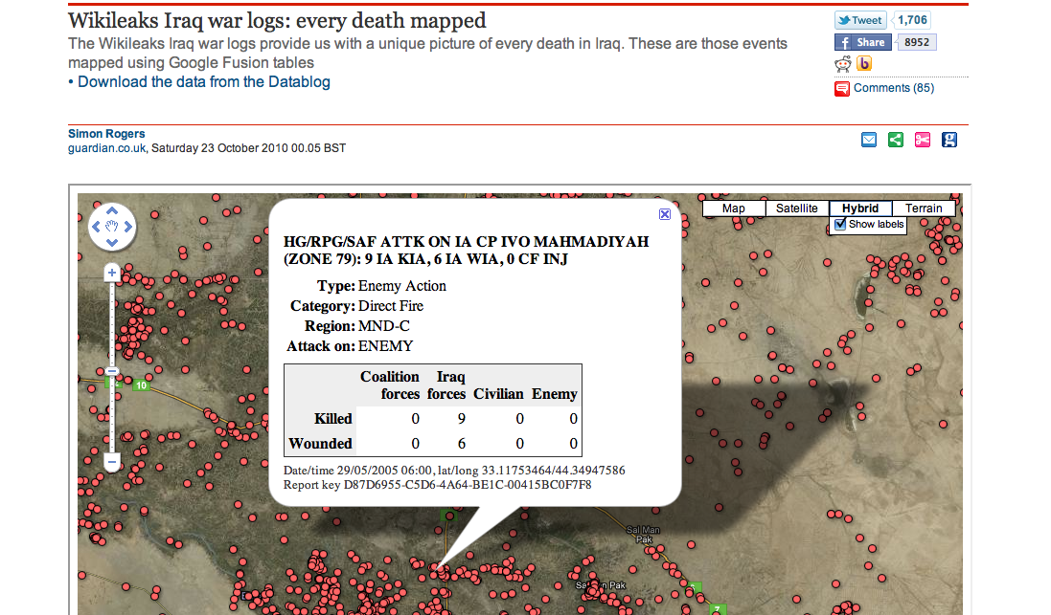

Slide 18
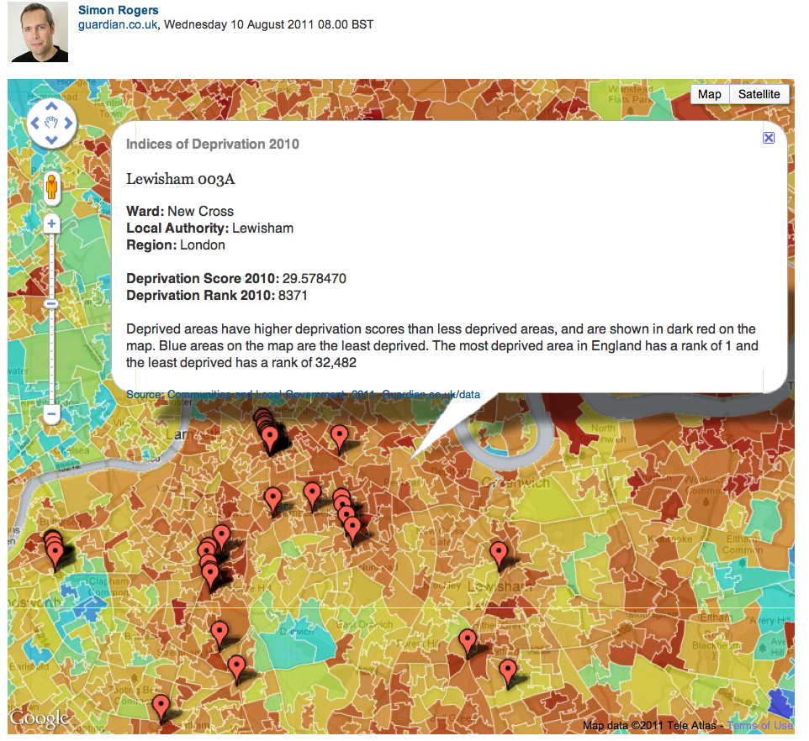

Slide 19
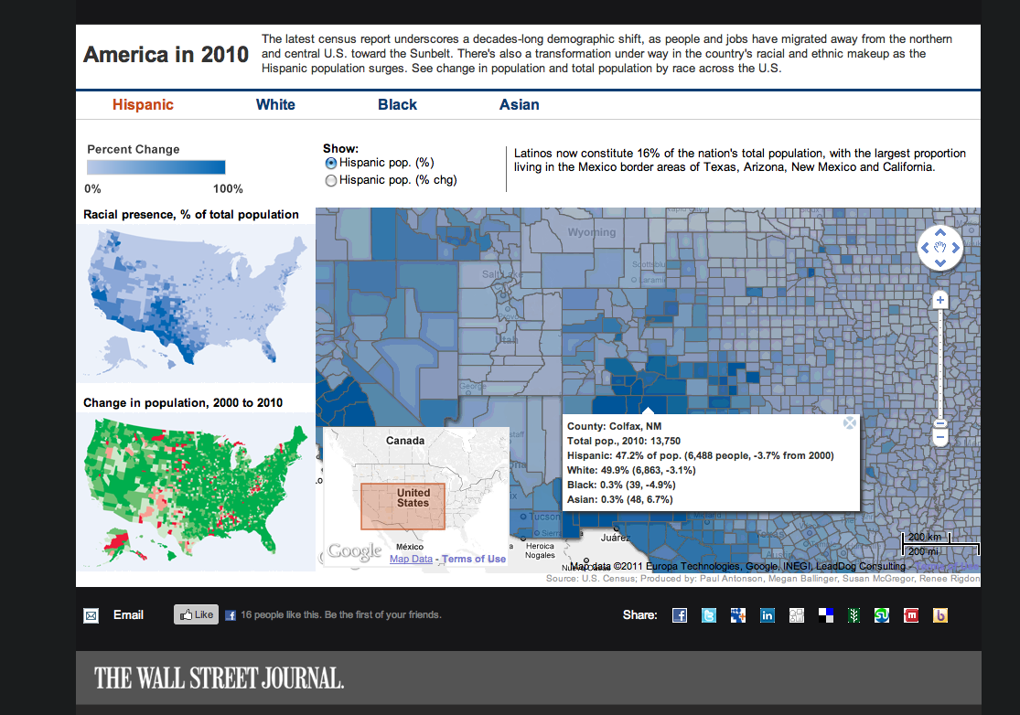

Slide 20
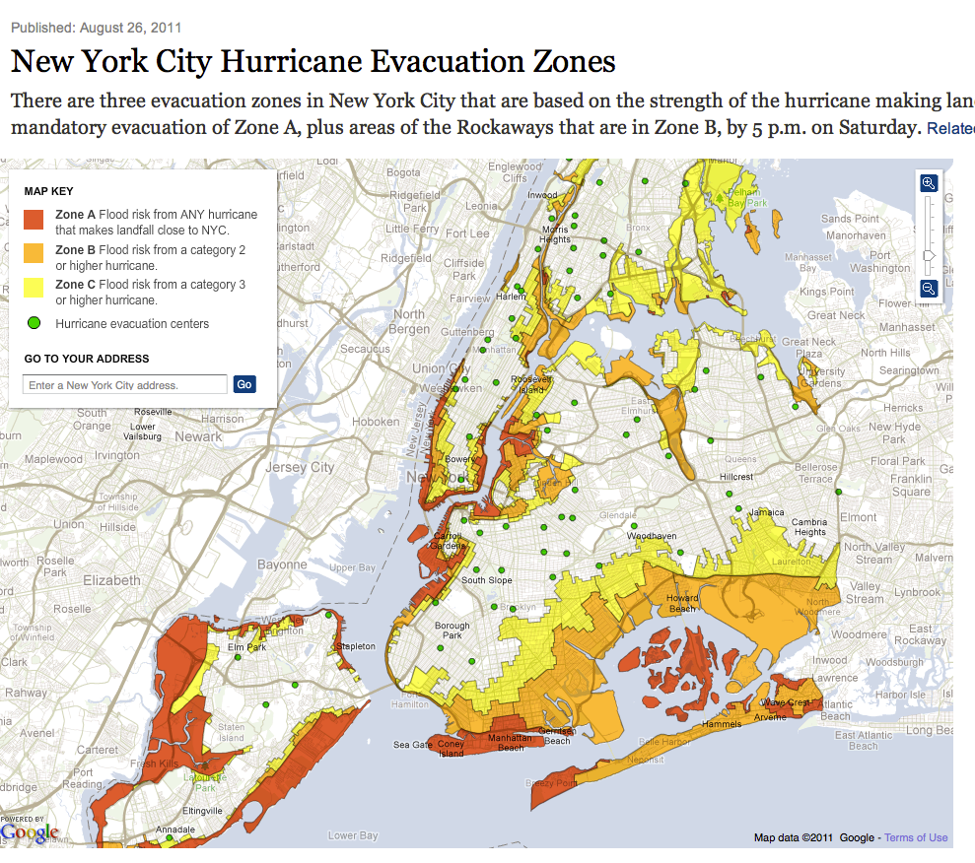

Slide 21
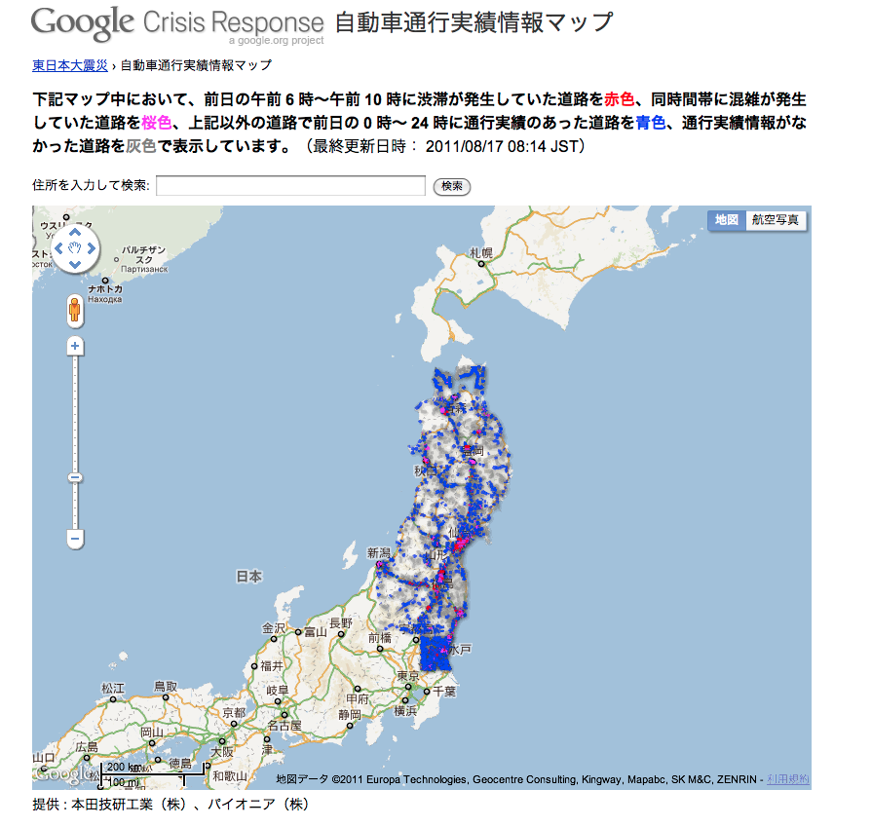

Slide 22
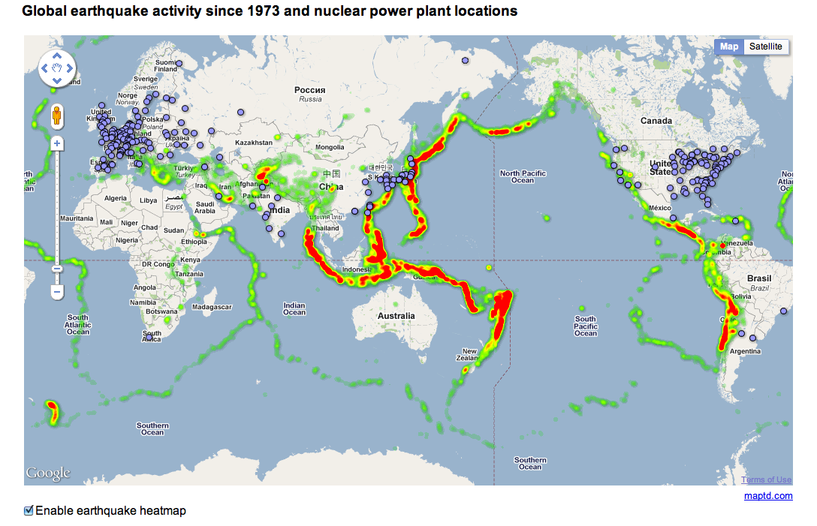

Slide 23
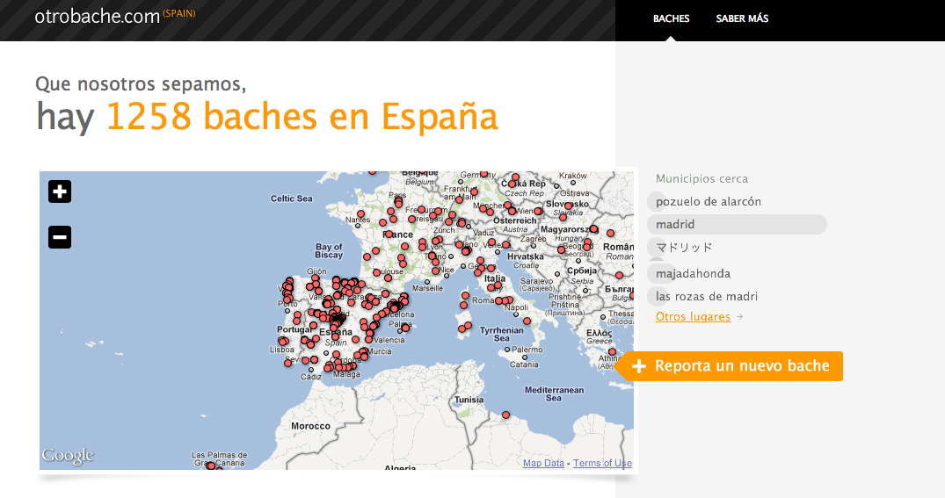
Crowd Sourcing

Slide 24
A GIS in the Cloud
That’s not what we set out to do, really.
Challenges:
Trickling: show only a small number of features (points, polygons) from a large data set
Need to thin polygons, clip to the window
Style features on the fly
All in less than 100ms

Slide 25
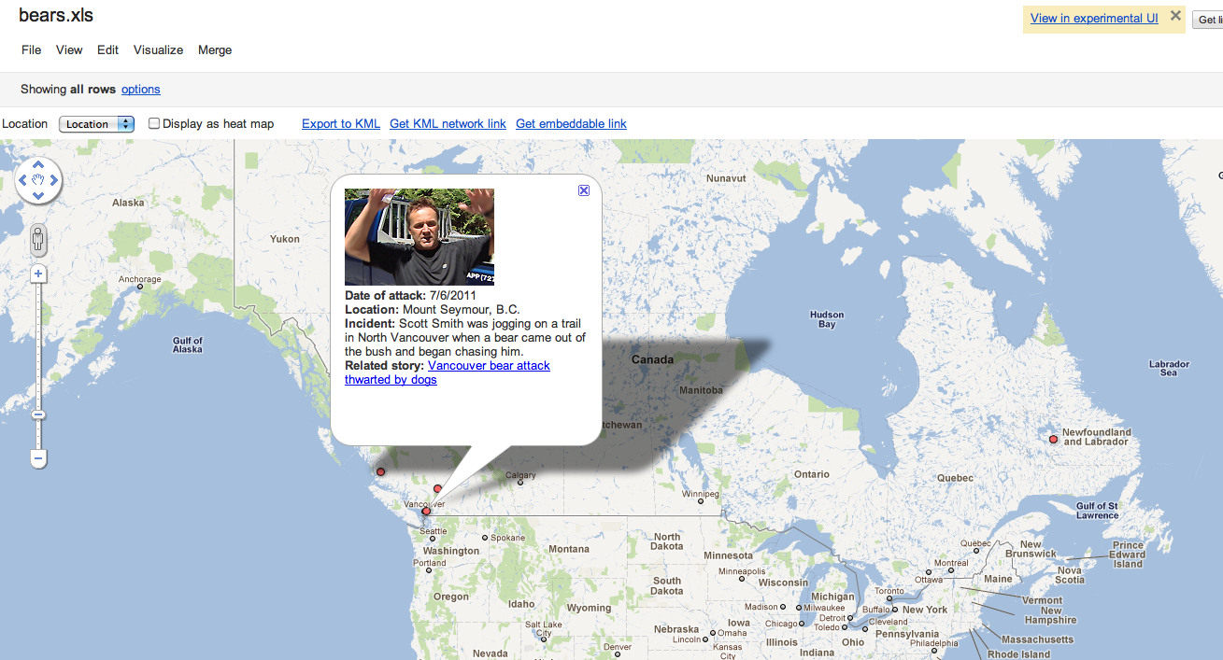
Bears in Canada

Slide 26
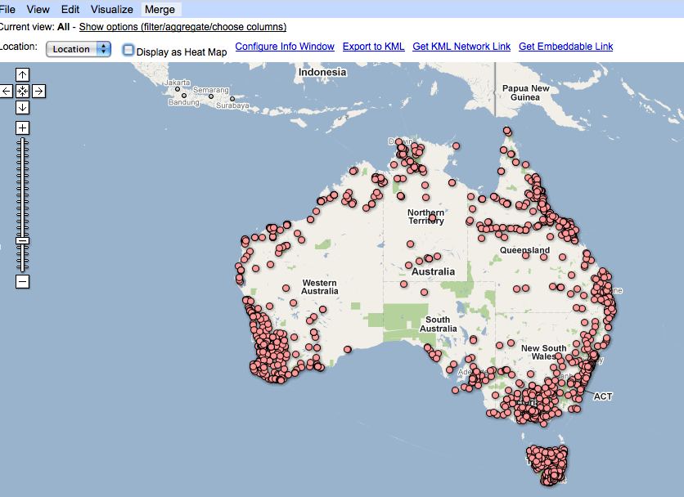
Public toilets in Australia

Slide 27
Conclusions
We have taken some small steps towards building a structured data eco-system
Fusion Tables provides a data sharing , joining and publishing platform
Public Data Explorer make high quality public data more discoverable and useful
Much is left to do
Better visualizations, data cleansing and transformations
And .. much wider participation from both providers and consumers of data

Slide 28
And the Credit Goes to…
Hector Gonzalez
Jayant Madhavan
Heidi Lam
Hongrae Lee
Warren Shen
Anno Langen
Rebecca Shapley
Alon Halevy
Anish Das Sarma
Boulos Harb
Fei Wu
Cong Yu
Spiros Papadimitriou

Slide 29
A Few References
Communications of the ACM: Feb 2011
Deep web: VLDB 2008
WebTables: VLDB 2008, 2009, 2011
Fusion Tables: SIGMOD 2010, SOCC 2010
google.com/fusiontables
Principles of Data Integration (Doan, Halevy, Ives): Morgan Kaufmann, 2012.

